Slide 1
Remote Control System 7 Advanced Training

Slide 2
RCS installation vectors.
Notes:
So what are we talking about today?

Slide 3
The RCS backdoor is a software.
You have to install it.

Slide 4
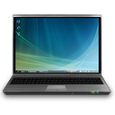
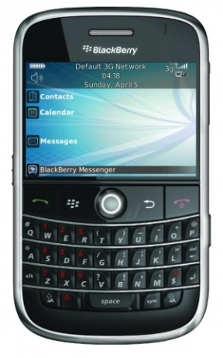
…Where?
On the target’s device.
Anything that runs a modern operating system.
…How?
RCS Infection Vectors
Local/Remote
Notes:
Desktops, Laptops, Smartphones, Tablets…

Slide 5
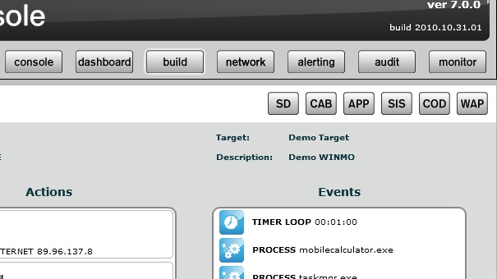
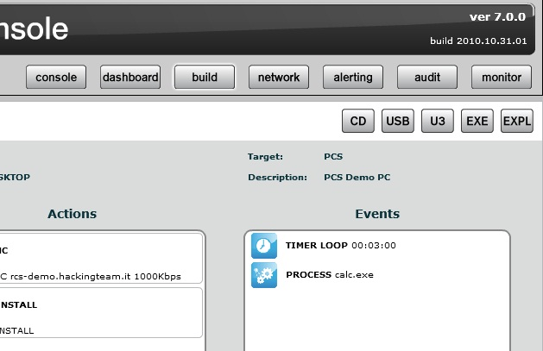
Infection Vectors 1/2
Mobile :
- SD Card
- Smartphone applications
- ActiveSync
- RMI
Desktop :
- Bootable CD/USB thumb
- U3 USB
- Exploit Portal
- Injection Proxy Appliance
Notes:
Here we face different scenarios…

Slide 6
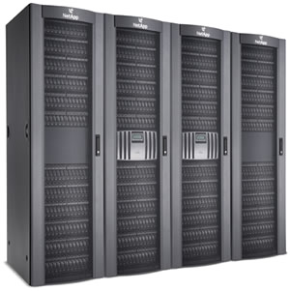
Infection Vectors 2/2
Injection Proxy Appliance

Slide 7
Best practices…
Success depends on 3 key point:
Infection Vectors combination
Social Engineering
Good Luck

Slide 8
HOWTO: U3 Thumb
build your U3 .iso file from the RCS Console and save it on the Desktop
install the application Universal Customizer - rename your .iso file with this name "U3CUSTOM.iso"
overwrite your .iso file on the existing one to this path:
C:\<installation path>\Universal_Customizer\BIN
run the Universal Customizer application: "Universal_Customizer.exe" - follow the automatic steps
Notes:
For desktop: EXE, APP
For mobile: CAB, COD, SIS
*** DEMO ***

Slide 9
HOWTO: Bootable USB Thumb
For Windows Vista or sup.
Insert a blank USB disk in the system: wait until Windows detect the removable disk and install the correct drivers
run "diskpart" system tool (from cmd.exe)
on prompt, type "list disk"
check the usb removable disk number (usually disk 1)
type "select disk <number_of_the_usb_disk>"
type "clean”
type “create partition primary”
type "select partition 1"
type "active"
type “format fs=fat32”
type “assign”
type "exit"
Notes:
For desktop: EXE, APP
For mobile: CAB, COD, SIS
*** DEMO ***

Slide 10
HOWTO: Injection Proxy Appliance
For wireless scenarios.
Check that Ipa is up and running and it’s reachable by rcs server.
Get access to the IPA and edit the file /rcsipa/ect/rcsredirect.conf
Uncomment the variable “wifi-key” and assign the key of the network you want to monitor.
Check that the sniffing and the response interfaces are properly assigned in the file and that are up and running.
Check that the monitor interface is in monitor mode:
> iwconfig [interface] mode monitor
Let the response interface join to the wireless network:
> iwconfig [interface] essid [network] key [key]
Get access to rcs console and configure the ipa with the sniffing rules.
Notes:
Continue…

Slide 11
HOWTO: Remote Mobile Infection
For Windows mobile phones.
Get access to the console, select a mobile backdoor and create a .CAB file in the Build section ( it’s also possible to trop it with another .CAB file).
Get access to the server where the Frontend of RCS is hosted
Copy the .CAB in the location:
C:\RCSASP\EXPREPO
Click on the WAP button and edit the Wap Push settings
Insert the target number
Insert the web URL pointing to the .CAB copied in the EXPREPO
Send the sms.
Notes:
Continue…

Slide 12
HOWTO: Exploit Portal
For Windows mobile phones.
Get access to the console, select a desktop backdoor and create a .EXE file in the Build section.
Get access to the server where the Frontend of RCS is hosted
Copy the .EXE in the location:
C:\RCSASP\EXPREPO
Click on the EXP button and edit the Exploit Portal settings
Select the vulnerability you want to exploit
Insert the web URL pointing to the .EXE copied in the EXPREPO
Click “Create” and save the file.
Notes:
Continue…

