Slide 1
The Hacking Suite For Governmental Interception

Slide 2




Notes:
Not only...

Slide 3
The Web is moving to HTTPS.
Encryption is increasingly more common.

Slide 4
Moreover, there’s too much data.

Slide 5
1 billion users on Facebook.
Billions of tweets per day.
Google #1 web site by number of visits.

Slide 6
You need focus.

Slide 7
Some data is never transmitted.
That data probably is very important.

Slide 8
Mobility makes traditional monitoring limited.
The device may be out of reach.

Slide 9
Encryption.
Noise.
Mobility.
They make you blind.
Notes:
Not evading. Not defeating.

Slide 10
Having the big picture is fine.
Small details can make a big difference.

Slide 11
You want a solution.

Slide 12


Slide 13


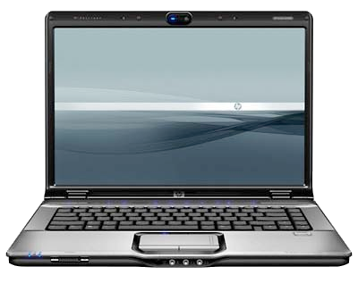
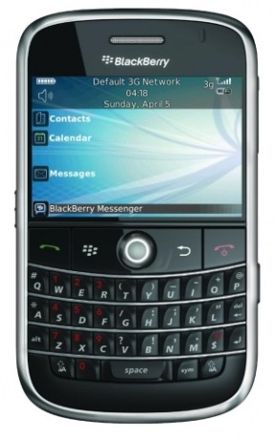

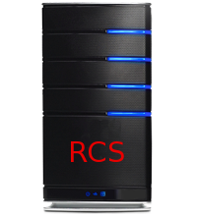
Internet
Notes:
Desktop installation
Mobile Installation
Working offline…
Then send data.

Slide 14
Runs on the target device.
Collects everything, constantly.

Slide 15
Easy to configure.
Zero to done in less than 2 minutes!

Slide 16
Scale with no hassles.
Runs on autopilot.

Slide 17
Large installations.
Distribute your data across cities.

Slide 18
1 or 10000 targets.
It makes no difference.

Slide 19
Search & filter.
Access your information quick and easy.

Slide 20
The device becomes a detail.
Target centric.
Ease investigation.

Slide 21
Invisible to antiviruses.
Prevent disclosure of your presence.
Notes:
Antiviruses are a must-have these days. There is lots of malware on the Net.
And if you fear your target will use an antivirus to prevent any unwanted application on his system, you’re right, they probably will. But RCS is invisible to them.

Slide 22

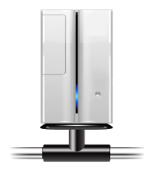





Notes:
Let’s say we have RCS in one country…
And the backdoor in another…
Suppose you control a number of server around the world.
You may think of forwarding the traffic…

Slide 23
Our Agents run on all platforms.

Slide 24







Notes:
Enough of features. Let’s see on what devices you can operate the RCS. On Windows for sure, so 90% of the desktop market is covered.

Slide 25
Wide selection of installation vectors.
Notes:
Maybe you want to be sneaky. Like a sniper: clean, precise, low profile.

Slide 26
Install an agent with an SMS.
Notes:
You send him an SMS and your RCS agent is ready to operate. Sounds like science fiction? It’s not.

Slide 27
Embed agents into documents.
Use zero day exploits.

Slide 28
Are you connected right now?
Notes:
Today philosophy is “no more cables”. Everything goes over the air.
WiFi anyone? We have that too.

Slide 29
Embed Agents into any web page and
downloaded application.
Notes:
He downloads the lastest version of his favourite application and together with it, an RCS agent comes down the wire and silently install itself on the system.
Not kidding.

Slide 30
Tactical WiFi.

Slide 31
Deploy at the ISP.
Notes:
You go directly at the target ISP, with little information you identify your target … and then? You cannot cut the cables and put something in between!
You don’t need to. Our solution works without being physically in the middle.
As soon as the target downloads an application, your RCS agent is up and running. Too late for him.
It’s easy to deploy, and light on the ISP side.
You manage it, the ISP doesn’t need to do anything.
And if you’ve access to a router, it works everywhere, not only at the ISP.

Slide 32
…not enough?

Slide 33

Correlation.

Slide 34
Digital identities.
Target to target communications.
Anomalies.
Highlight patterns.

Slide 35
Come see our demos!

