Slide 1
Remote Control System
The Hacking Suite For Governmental Interception

Slide 2
The building blocks

Slide 3
Remote agent
Secure frontend
Scalable backend
Infection vectors

Slide 4
Complete solution, not a toolkit
Totally developed by us

Slide 5
Remote Agent
Your personal 007

Slide 6
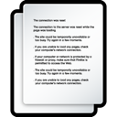

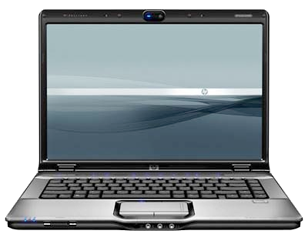
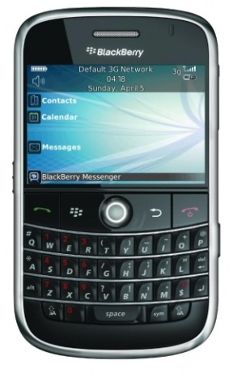

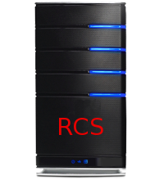
Internet

Slide 7
What can we collect?

Slide 8



Notes:
Not only...

Slide 9
Microphone
Messaging
Documents
Passwords
Printing
Location
Camera snapshots
Keystrokes
Visited websites
… and more

Slide 10
Runs on an event-driven logic
Autonomous

Slide 11
Events
When crossing the border
Every day at midnight
On low battery
Entering a protected website
Actions
Start microphone recording
Destroy the device
Send collected data
Take a camera snapshot
Notes:
Can be combined to create a frist degree logic

Slide 12
Many different events and actions
Combine them to suit your needs

Slide 13
What if my target is security aware?

Slide 14
Invisible to the target user
Invisible to most common antiviruses
Resistant to format and restoration
Notes:
The user won’t notice any strange file or process, any slow down, any strange network traffic

Slide 15
Evidence on remote device
How can we collect it?

Slide 16
Internet connection
Firewalls and proxies are passed through

Slide 17
  WiFi
  Open and saved networks

Slide 18
GPRS / UMTS / 3G / LTE
Avoid billing the target with custom APN

Slide 19
Where can I install the Agent?

Slide 20






Notes:
Enough of features. Let’s see on what devices you can operate the RCS. On Windows for sure, so 90% of the desktop market is covered.

Slide 21
Soon to be released …
Windows Phone 8

Slide 22
Frontend
An invisible barrier

Slide 23
Agents are connecting to your servers
Your identity must be kept secret

Slide 24

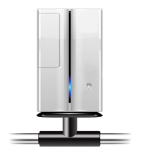





Notes:
Let’s say we have RCS in one country…
And the agent in another…
Suppose you control a number of server around the world.
You may think of forwarding the traffic…

Slide 25
Configurable on-the-fly
Evidence stays encrypted

Slide 26
Backend
Your data vault

Slide 27
Scalable by design

Slide 28
Agents
x 300
Collector
Database

Slide 29
Agents
x 10000
Collector 1
Collector 2
…
Collector N
Database
Shard 1
Shard 2
…
Shard N

Slide 30
Scale when you need
Adding servers is transparent
Load balancing is automatic

Slide 31
No database administration required
Set & Forget backups
Fast restore in 5 minutes

Slide 32
Real-time alerting
Be informed on interesting events

Slide 33
Polished graphical console
The whole system from a single point

Slide 34
Infection Vectors
Deploy your forces

Slide 35
How can I deploy my agent?

Slide 36
When the target opens a document

Slide 37
0-day exploits pack
Always up to date

Slide 38
While the target browses the web

Slide 39
Inject into downloaded applications or updates
Inject into Web pages

Slide 40

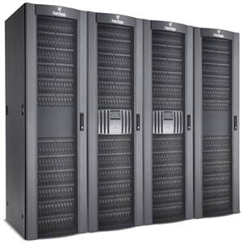
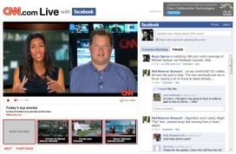


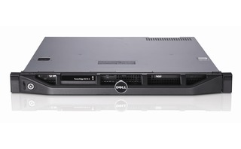
Bob’s laptop
Internet
Web site
Network Injector

Slide 41

Send your target a SMS

Slide 42
And many more…

Slide 43
Third-party integration
Combine your weapons

Slide 44
Easily integrate with your monitoring center

Slide 45
Demo time!

