Slide 1
REMOTE CONTROL SYSTEM V7
www.hackingteam.it

Slide 2
Introduction

Slide 3
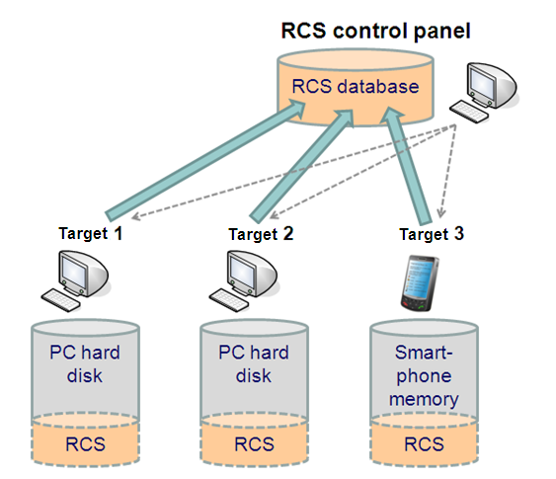
System Architecture

Slide 4
Backdoor Functionalities (PC & Mobile)

Slide 5
PC Version Monitoring and Logging
Remote Control System can monitor and log any action performed by means of a personal computer
Accessed URLs
Accessed documents
Keystrokes
Printed documents
Chat, e-mail, contacts, instant messaging
Remote Audio Spy
Localization (wifi)
Camera snapshots
VoIP (Skype, MSN, etc.) conversations
FileSystem browsing

Slide 6
PC Version Online Captured data transmission
Connects through the internet to the collection node
Collection nodes can be hidden behind an anonymizing chain
Works both in home and enterprise environments
Network Firewalls (passed through)
Web Proxies (passed through)
Domain credentials (stolen)
6
© Hacking Team
All Rights Reserved
6
© Hacking Team
All Rights Reserved

Slide 7
PC Version Offline data retrieving
No internet connection required
Data can be exported in an encrypted format to any external device (eg: USB dongle)
Data can later be imported into the database
7
© Hacking Team
All Rights Reserved
7
© Hacking Team
All Rights Reserved

Slide 8
PC architectures
Windows XP/Vista/2003/2008/7 (32/64bit)
Mac OS X
Linux (Q2 2011)

Slide 9
Mobile Version Monitoring and Logging
Remote Control System can monitor and log any action performed by means of a smartphone
Call history
Address book
Calendar
Email messages
SMS/MMS interception
Localization (cell signal info, GPS info, wifi)
Remote Audio Spy
Camera snapshots
Voice calls interception
…
9
© Hacking Team
All Rights Reserved
9
© Hacking Team
All Rights Reserved

Slide 10
Mobile Version Online Captured data transmission
Connection via GPRS/UMTS/3G to the Collection Node
Configurable custom APNs
Connection through any open/preconfigured WiFi network to the Collection Node
Automatic APs detection
Connection via BlueTooth/WiFi to the Mobile Mediation Node (data can later be sent to the database)
10
© Hacking Team
All Rights Reserved
10
© Hacking Team
All Rights Reserved

Slide 11
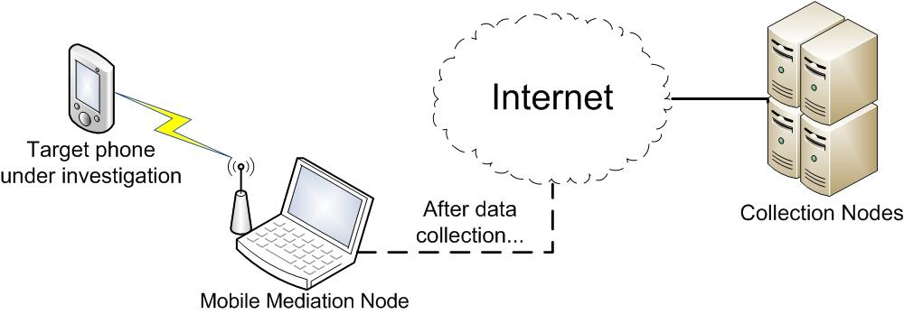
Mobile Version Mediation Node
Useful if the target cannot access any WiFi or 3G/GPRS Network
11
© Hacking Team
All Rights Reserved
11
© Hacking Team
All Rights Reserved

Slide 12
Mobile Configuration
As for the PC version, Remote Control System for Mobile devices can be re-configured after each synchronization...
... And ‘on the fly’:
Control SMS: messages sent from a pre-configured phone number can be used to control the backdoor.
Control SMS are completely invisible to the user and they leave no trace on the phone.

Slide 13
Mobile architectures
Windows Mobile 6 6.5
iPhone OS 2 4
Symbian S60 3rd edition
BlackBerry OS >= 4.5
Android (Q1 2011)

Slide 14
System features

Slide 15
Invisibility
After the installation, Remote Control System cannot be detected by any infected user
Existing files are not modified
No new files appear on the computer’s hard disk
No new processes are executed
No new network connections are established
Antivirus, antispyware, anti-key-loggers cannot detect our bug
E.g. Gartner Endpoint Security Magic Quadrant

Slide 16
Flexibility
Goes beyond logging and monitoring
Has a real-time alerting system
Allows performing actions on an infected device
Search and view data on the hard disk
Execute commands remotely
Possibly modify hard disk contents
Inner logic for automated response (No human interaction required)

Slide 17
Inner Logic (1)
It is based on an Event/Action paradigm
Events:
On ScreenSaver
Time based
On SMS reception
On GPS position
...
Actions:
Synchronize
Uninstall
Start/Stop Agent
Send SMS
Execute command

Slide 18
Inner Logic (2)
Some examples...
Screen saver starts -> Send data
SIM changes -> Send SMS with SIM information
Received Covert SMS -> Send SMS with GPS position
On GPS position -> Start the Microphone capture and Send SMS with GPS position
Incoming/outgoing call -> Make a camera snapshot

Slide 19
Infection

Slide 20
Attack/Infection vectors
Remote Control System is software, not a physical device
Which can be installed remotely
Computer can be bugged by means of several infection vectors
Intelligence information about remote target mandatory
… but local installation remains an option
Usually very effective

Slide 21
PC Installation (1)
Remote infection vectors
Executable melting tool
Injection Proxy
HT Zero-day Exploits portal

Slide 22
PC Installation (2)
Local infection vectors
Bootable CDROM or USB pen drive
Direct hard disk infection by means of tampering with computer case
HT consultancy
Anonymous attack scenario analysis
E.g., Internet Café using DeepFreeze

Slide 23
Mobile Installation
Local Infection:
Memory Card
Through an infected PC
when connected for synchronization/recharging
Remote Infection:
CAB/SIS/COD Melting
Special crafted SMS (WAP Push)

Slide 24
Demo time!

Slide 25
Q&A

