Slide 1
REMOTE CONTROL SYSTEM 6.1 A Stealth, Spyware-Based System for Attacking, Infecting and Monitoring Computers and Smartphones. Full intelligence on target users even for encrypted communications (Skype, PGP, secure web mail, etc.)
www.hackingteam.it

Slide 2
What the press says
“governments must have offensive capabilities”
“the new frontier of intelligence is cyberspace”
“spy on suspected terrorists by inserting a remote forensic agent on their computers”

Slide 3
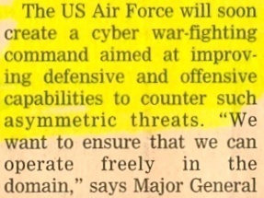
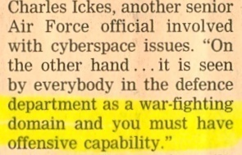
Financial Times

Slide 4
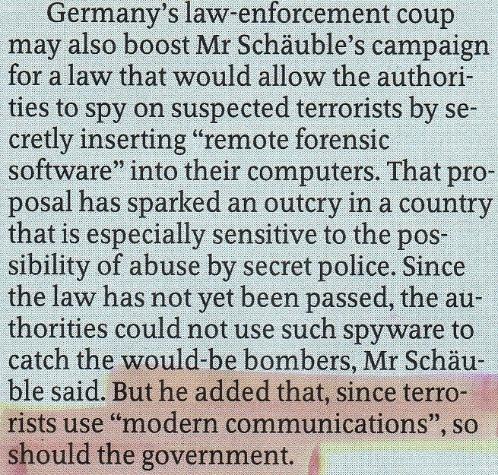
The Economist

Slide 5
The Economist

Slide 6
Introduction

Slide 7
Hacking Team Ltd
HT is a 100% Italian company founded in 2003 by Valeriano Bedeschi and David Vincenzetti
Venture-backed in 2007 by two Italian VC funds
Market leader for penetration testing (Ethical Hacking) services in Italy
In 2004 HT has developed a pretty unique technology for attacking, infecting and remotely controlling targets (PCs, MACs, smartphones of different types)

Slide 8
Hacking Team, financials
Huge market traction
First mover advantage
Rapid growth to market dominance
Financially very strong
2009 results (YoY, Estimated)
Revenues: +33%
EBITDA: +51%
EBIT: +150%

Slide 9
What actually happens
IT offensive security represents a new and highly innovative technology
It’s growing very fast because of phenomena such as terrorism, industrial espionage and insider trading
Advanced use of the Internet by terrorists makes LEAs increasingly nervous
Example: the exponential growth of encrypted VoIP communications (Skype claims millions of users) by residential and business users, is often a problem for LEAs

Slide 10
Why IT offensive security
Cyber space is a very attractive place for criminals: It’s cheap, quick and easy to access
IT offensive security systems can be complementary to more traditional passive IT monitoring solutions
Governments need to have both defensive and offensive (IT) capabilities

Slide 11
IT offensive security
Operational scenarios:
“Standard” criminal investigation (evidence gathering) performed by Government Organizations such as Police and Anticorruption.
Intelligence gathering activities performed by Security Agencies for tracking down crime organization and fighting terrorism

Slide 12
Remote Control System
Remote Control System is an IT stealth investigative tool for LEAs.
It allows passive monitoring and active control of all data and processes on selected target devices.
Such devices might or might not be connected to the Internet.
`

Slide 13
Functionalities

Slide 14
Monitoring and Logging
Remote Control System can monitor and log any action performed on the target personal computer
Web browsing
Opened/Closed/Deleted files
Keystrokes (any UNICODE language)
Printed documents
Chat, email, instant messaging
Remote Audio Spy
Camera snapshots
VoIP conversations (eg: Skype)
…

Slide 15
PC architectures
Windows XP
Windows 2003
Windows Vista
Windows 7
Mac OS X (Leopard 10.5.x)

Slide 16
Monitoring and Logging
Remote Control System can monitor and log any action performed on the target smartphone
Call history
Address book & Calendar
Email messages
Chat/IM messages
SMS/MMS interception
Localization (cell signal info, GPS info)
Remote Audio Spy
Camera snapshots
Voice calls interception
…
© Hacking Team
All Rights Reserved
16

Slide 17
Smartphones architectures
Windows Mobile 5
Windows Mobile 6
Windows Mobile 6.5
iPhone OS 2.x
iPhone OS 3.x

Slide 18
Clear technology & product roadmap to market dominance
Linux
Symbian
Injection Proxy Appliance
Mac OS X Snow Leopard (10.6)
HT Exploit Portal for remote infection
Windows 7
Q1 2010
Q2 2010
Q3 2010
Q4 2010
© Hacking Team
All Rights Reserved

Slide 19
Key Features

Slide 20
Key features
Invisibility: Anti-viruses, anti-spywares, anti-rootkits, anti-keyloggers cannot detect our product
It is resistant to all products in 2009 Gartner Endpoint Security Magic Quadrant (Gartner is likely the most respected name in IT research worldwide)
Flexibility: advanced logic based on event/action paradigm
Send data only when the target is away
Activate microphone only when inside a given location
and many more...
Advanced installation: can be installed locally or remotely by means of various attack vectors

Slide 21
Key features
Robustness & Scalability: the solution can scale up to unlimited numbers of targets and each investigation can be assigned to different teams
Integration with LI platforms: it can be integrated with existing investigation platforms. Data can be automatically forwarded to them once they arrive to our Collection Node
Uniformed management: a single console to configure the agents, perform data analysis, configure the attack vectors, manage the users and monitor the system
Privilege separation: each user/group can be granted with different privileges and assigned to different activities

Slide 22
Key features
Stealthiness: the Collection Node can be hidden behind a chain of anonymizers which can be easily changed on the fly
Data mining: evidences can be easily retrieved and visualized performing advanced filtering on collected data
Alerting: you can be alerted when sensitive data arrives in the system
E.g. you were waiting for a particular password to be recorded or a particular file to be opened on an encrypted volume

Slide 23
Use cases

Slide 24
Voice Communications
Issue: the targets are using encrypted VoIP to communicate
The voip agent is able to record audio before the encryption and after the decryption
The microphone agent can be used to record the surroundings even if the target is not using the computer to communicate

Slide 25
Encrypted chat
Issue: the target is using a third party encryption plugin (such as OTR) over common chat protocols (MSN, Yahoo!, Gtalk, Skype)
The chat agent is able to capture data before the encryption and after the decryption
You don’t have to worry about encryption anymore

Slide 26
PGP Encrypted data
Issue: passive interception can record data, but can not decrypt it
The file capture agent can be used to retrieve the private keyring of the target
The keylog agent can be used to view the passphrase for the private keyring
Recorded data can now be decrypted

Slide 27
Webmail interception
Issue: modern webmails are really a mess to be decoded on LI platform (ajax & co.)
The URL agent can make a screenshot of the visited page (incoming emails)
The keylog agent can be used to capture outgoing emails while the user is writing
The clipboard agent can capture the body if it is copy-and-pasted (PGP tray)

Slide 28
Deepfreezed Internet Cafe
Issue: Rootkits don’t survive reboot of DeepFreezed computers
Our solution is DeepFreeze resistant
Just install it

Slide 29
Final words

Slide 30
Why trusting HT?
Reputation
Our software has been widely deployed and is used for national security issues worldwide
No remote access to data from HT
The infrastructure is totally at customer’s site
No “hidden features” inside
You can have a full source code walk–through

Slide 31
Sales cycle
Delivery
SAT
Advanced training
Continuous on-site presence
Support portal
Exploit portal

Slide 32
mailto:
info@hackingteam.it

