Slide 1
The Hacking Suite For Governmental Interception

Slide 2
maybe you already know this…

Slide 3
What can the Agent collect?

Slide 4









Notes:
Not only...

Slide 5
and many more…

Slide 6











Slide 7
Where can I deploy the Agent?

Slide 8








Notes:
Enough of features. Let’s see on what devices you can operate the RCS. On Windows for sure, so 90% of the desktop market is covered.

Slide 9
How can I deploy the Agent?

Slide 10
When the target opens a document

Slide 11
Integrated 0-day exploits pack
Always up to date

Slide 12
While the target browses the web

Slide 13
Inject into applications or updates
Inject into Web pages

Slide 14



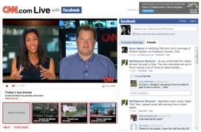


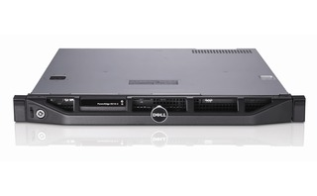
Bob’s laptop
Internet
Web site
Network Injector

Slide 15

Send your target a SMS

Slide 16
and many more…

Slide 17
See them in action
Tomorrow 10.30
Track 4

Slide 18
but for sure you don’t know this…

Slide 19
Introducing Intelligence

Slide 20

Identify targets’ network

Slide 21
Digital identities
Target to target communications
Anomalies
Highlighted patterns

Slide 22
Add actively intercepted data to your correlations

Slide 23
…now let’s see the real thing!

