Slide 1
The Hacking Suite For Governmental Interception

Slide 2
Today’s topic:
RCS installation vectors.
Notes:
So what are we talking about today?

Slide 3
The RCS Agent is a software.

Slide 4
You have to deploy it.
Notes:
This is the key point of the whole solution. If you cannot install it, you cannot retrieve the data you need.

Slide 5
On the target’s device.
Anything that runs a modern operating system.
Notes:
Desktops, Laptops, Smartphones, Tablets…

Slide 6
Locally.
Remotely.

Slide 7
Let’s talk about local.
You have access to the target device.
Notes:
Here we face different scenarios…

Slide 8
Boot from a USB thumb drive.
Plug a USB cable.
Notes:
Desktop
Mobile
Hard drive tampering for desktop, usb connection for mobile (need to know the pin)

Slide 9
Easy installation.
100% success.

Slide 10
Let’s talk about remote.
No physical access this time.

Slide 11
Deploy RCS while the target is…
Notes:
Using the INFECTION AGENT
Only from desktop (win) to mobile (winmo)

Slide 12
Browsing the internet.
Notes:
Using the INJECTION PROXY
Wired or wireless
No matter if Desktop or smartphone. Just modify its traffic.

Slide 13
Opening a document file.
Notes:
Using the HT Zero Day Exploit Portal

Slide 14
Receiving a SMS.
Notes:
Using the REMOTE MOBILE INSTALLER

Slide 15
Complicated scenario?

Slide 16
Rely on our consultancy services.
i.e.
BlackBerry controlled via BES.
Windows PC in an enterprise domain.
Notes:
We provide consultancy

Slide 17
RCS has a simple and unified console.
Your attacks are just one-click away.

Slide 18
Demo Time!

Slide 19
Exploitation
Integrated 0-day exploits pack.
Use documents as attack vector.
Use websites as attack vector.
Notes:
0) Factory to forge
1) FLAW, EXPLOIT
2) Word doc, Excel, PDF
3) Explorer or firefox
L)
Continue…

Slide 20
Exploitation
Easy to use exploit creation.
No skills required.
Notes:
*** DEMO in Vmware ***
Connessione e0
Menu
Forge doc
Copia su vmware
Run

Slide 21
Network Injector
Monitors the target and modifies its traffic.
Inserts code into downloads and updates.
Inserts code into web pages.
Notes:
Continue…

Slide 22
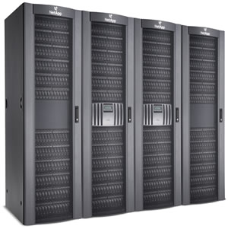
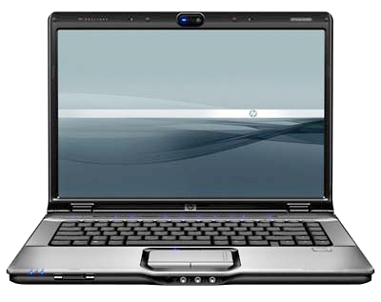
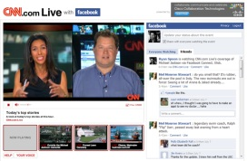
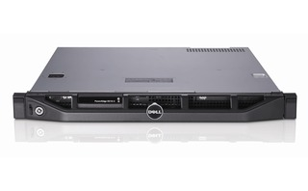
Bob’s laptop
Internet
Web site
Network Injector

Slide 23
Network Injector
It does the magic on-the-fly.
No need to be inline.
Think of it as a passive probe.
Notes:
Continue…

Slide 24
Network Injector
Use it at ISP level.
Notes:
ISP: hardware version (gigabit)
Small: software
*** DEMO ***

Slide 25
Network Injector
Use it on wi-fi networks.
Open or Protected…
Notes:
ISP: hardware version (gigabit)
Small: software
*** DEMO ***

Slide 26
Network Injector
“Is it possible to bypass HTTPS?”
Let’s see…
Notes:
ISP: hardware version (gigabit)
Small: software
*** DEMO ***

Slide 27
Disguised devices
Insert RCS code into ANY USB device.
Send, Lend, Sell them..
Automatic OS Recognition.
Notes:
*** DEMO ***

Slide 28
Spreading Infection
Jump from an infected PC
to
USB-connected smartphones.
Notes:
NO demo

Slide 29
Infecting Live Distros
Often used by criminal groups.
Defeats disk encryption.
Resident on the USB device.
Notes:
Demo

Slide 30
Remote Mobile Installation
Sends a special crafted SMS to the phone.
Once accepted, the phone will automatically install the Agent.
Notes:
Depending on the phone configuration the security settings are different.
*** DEMO ***

Slide 31
Remote Mobile Installation
Desktop vectors applies to mobile as well!
Notes:
Depending on the phone configuration the security settings are different.
*** DEMO ***

Slide 32
Q&A

