Slide 1
Remote Control System
Cyber intelligence made easy.

Slide 2
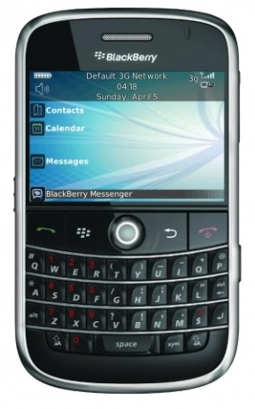
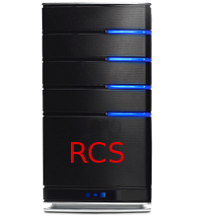
Notes:
Desktop installation
Mobile Installation
Working offline…
Then send data.

Slide 3
Evidence collection is always running.
Configurable behavior.
Autonomous.

Slide 4
What kind of evidences can be collected?

Slide 5
Voice conversations
Browsed URLs
Accessed documents
Keystrokes
Printed documents
Messaging
Microphone
Location
Camera snapshots
File system browsing
Passwords
… And more
Notes:
Social -> calendar + contacts

Slide 6
RCS collected the evidences.
They stay on remote device.
How can we gather them?

Slide 7
Let’s talk about Desktops first.

Slide 8
Internet connection.
Firewalls and proxies are passed through.
Domain credentials are stolen.

Slide 9
Evidence can also be collected offline.

Slide 10
What about mobile platforms?

Slide 11
GPRS / UMTS / 3G+.
You can provide a custom APN.

Slide 12
Open WiFi networks.
Known protected networks.
Access Points are automatically detected.

Slide 13
What happens if someone tracks the connection back?

Slide 14
Anonymizer Chain.
Prevents disclosure of RCS server addresses.
Configurable on-the-fly.

Slide 15
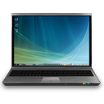
Notes:
Let’s say we have RCS in one country…
And the backdoor in another…
Suppose you control a number of server around the world.
You may think of forwarding the traffic…

Slide 16
RCS is also flexible.

Slide 17
Real-time alerting system.
Custom commands execution on remote target.
Event-driven logic.

Slide 18
A few examples of event-driven logic.

Slide 19
When entering the meeting room, start the mic.
On low battery, stop microphone capture.
Special SMS is received, send back a SMS with position.
Call is made or received, take a snapshot with the camera.

Slide 20
A huge amount of different events.
Combine them to suit your needs.

Slide 21
What if my target is very skilled?

Slide 22
Invisible to target user.
Invisible to antivirus and anti-rootkits.
Anti-forensic measures.
Resistant to format and restoration.

Slide 23
How can I install it on desktop systems?

Slide 24
Embed RCS into common file formats (0-day exploits).
On-the-fly injection into downloaded applications or updates.
Webpage code injection during browsing.

Slide 25
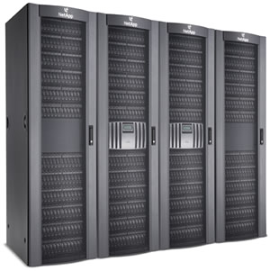

Slide 26
I’m lucky.
Physical access is granted.

Slide 27
Bootable CDROM or USB thumb drive.
Direct hard disk tampering.

Slide 28
What about installation on mobiles?

Slide 29
Memory Card.
ActiveSync while synchronizing or charging.
Embed RCS into smartphone applications.
Over-the-Air installation.

Slide 30
Supported platforms?

Slide 31
Microsoft Windows XP up to 8
Mac OS X from Leopard to Lion
Linux coming soon

Slide 32
Windows Mobile 6.0 up to 6.5
iOS 3.0 up to 4.2
Symbian S60 3rd & 5th edition
BlackBerry OS from 4.5
Android from 2.2

Slide 33
Demo time.

