Slide 1
Remote Control System 7
Cyber intelligence made easy.

Slide 2
Question: why?
Total control over people
Easy to use
Invisible and secure

Slide 3
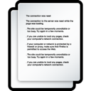
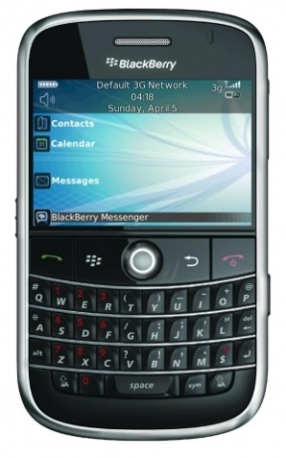
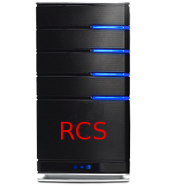
Notes:
Desktop installation
Mobile Installation
Working offline…
Then send data.

Slide 4
Deploy a hidden backdoor
Collect evidences
Watch data
Interact with your secret agents

Slide 5
Boot from CDROM or USB thumb.
Melt an executable.
Embed RCS into common file formats.

Slide 6
On-the-fly injection into:
downloaded applications
webpages during browsing.

Slide 7
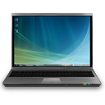
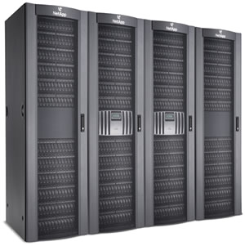
The Injection Proxy

Slide 8
Embed RCS into smartphone applications.
Put it on a memory card.
Send it over-the-air.

Slide 9
Supported platforms?

Slide 10
Microsoft Windows XP up to 7 (32 and 64 bits)
Mac OS X Leopard and Snow Leopard
Linux coming in Q4 2011

Slide 11
Windows Mobile 6.0 up to 6.5
iOS 3.0 up to 4.2
Symbian S60 3rd & 5th edition
BlackBerry OS from 4.5
Android from 2.2

Slide 12
Collect evidences

Slide 13
Voice conversations
Browsed URLs
Accessed documents
Keystrokes
Printed documents
Messaging
Location
Microphone
Camera snapshots
File system browsing
Passwords
… And more
Notes:
Social -> calendar + contacts

Slide 14
Evidence collection is always running.
Configurable behavior.
It’s autonomous.
It’s secure.

Slide 15
How we can gather evidences?

Slide 16
Internet connection.
GPRS / UMTS / 3G+ (also with custom APN)
Known protected or public WiFi .
Offline retrieving.

Slide 17
What if no data connection is available?

Slide 18
Bluetooth.
Short Range.
Let’s introduce RCS Mediation Node.

Slide 20
What happens if someone tracks the connection back?

Slide 21
Anonymizer Chain.
Prevents disclosure of RCS server addresses.
Configurable on-the-fly.

Slide 22
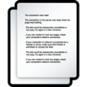
Notes:
Let’s say we have RCS in one country…
And the backdoor in another…
Suppose you control a number of server around the world.
You may think of forwarding the traffic…

Slide 23
Interact with your secret agents

Slide 24
Real-time alerting system.
Custom commands execution on remote target.
Event-driven logic.

Slide 25
When entering the meeting room, start the mic.
On low battery, stop microphone capture.
Special SMS is received, send back a SMS with position.
Call is made or received, take a snapshot with the camera.

Slide 26
Invisible and secure

Slide 27
Invisible to target user.
Invisible to antivirus and anti-rootkits.
Resistant to DeepFreeze restoration.
Encripted connection to the server

Slide 28
Demo time.

