Slide 1
Fairs&Events 2013

Slide 2
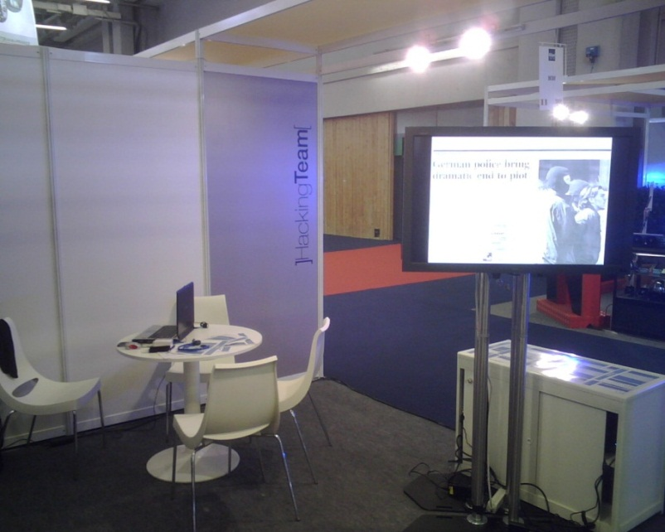
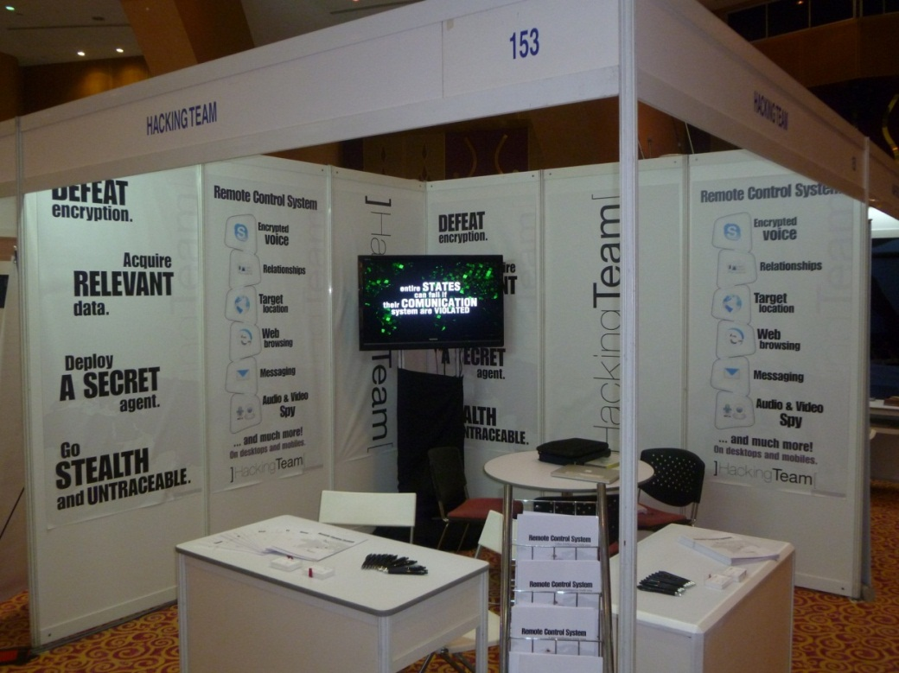
HackingTeam 2007 - 2011

Slide 3
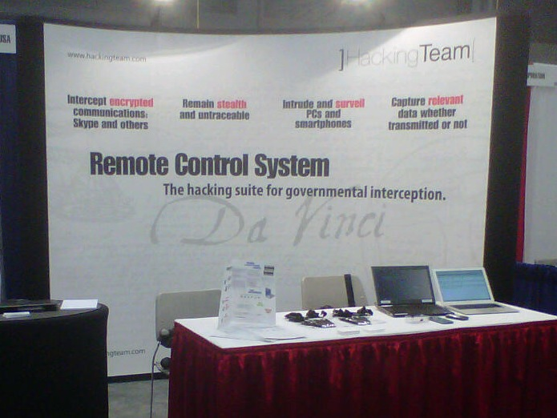
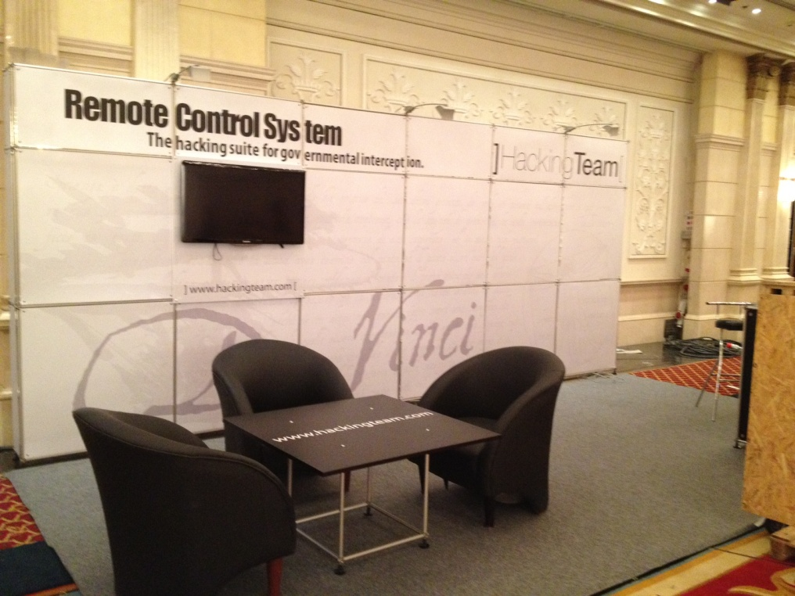
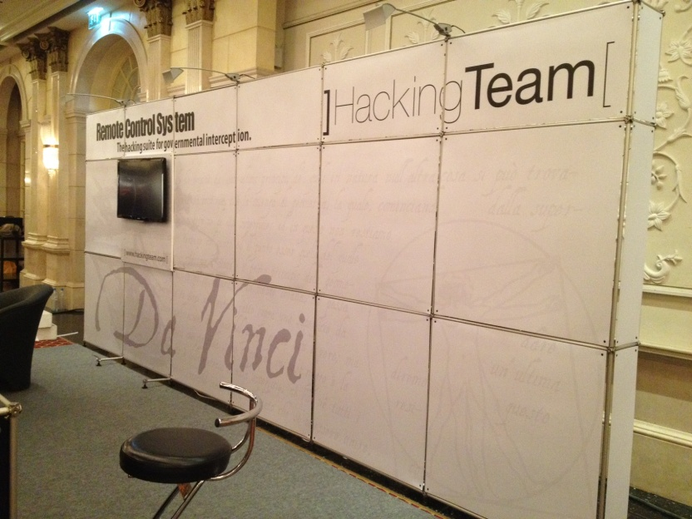
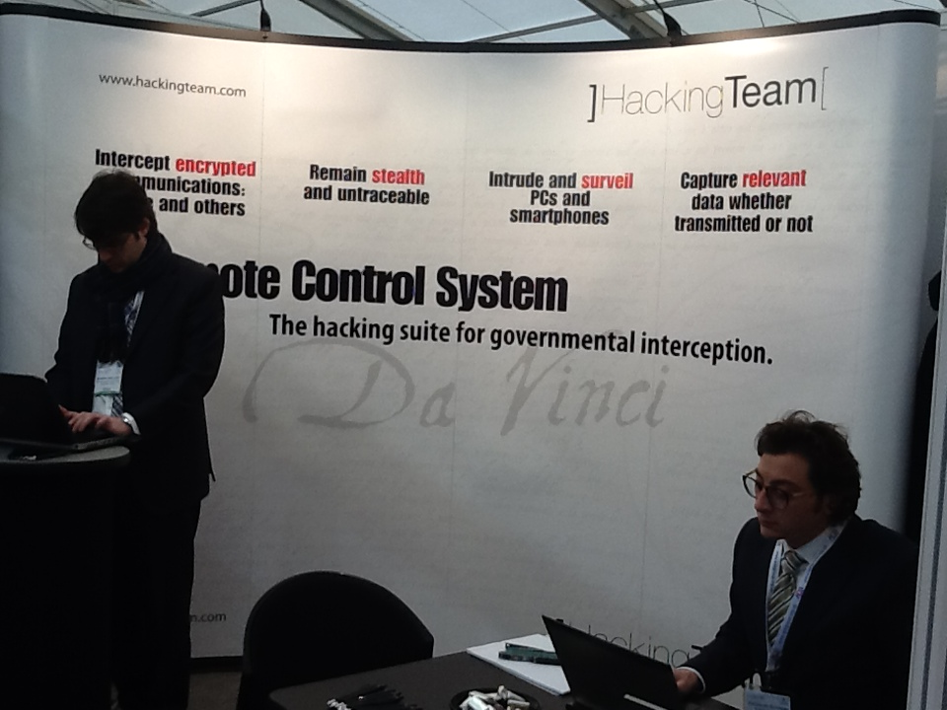
HackingTeam 2012

Slide 4
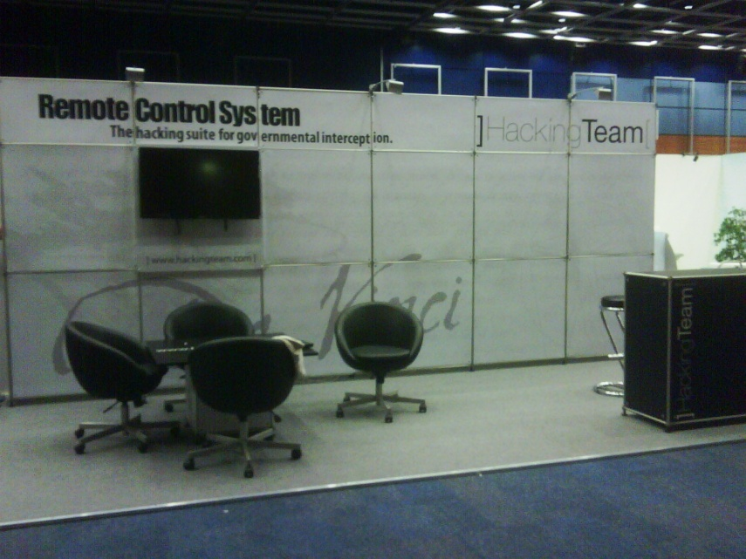
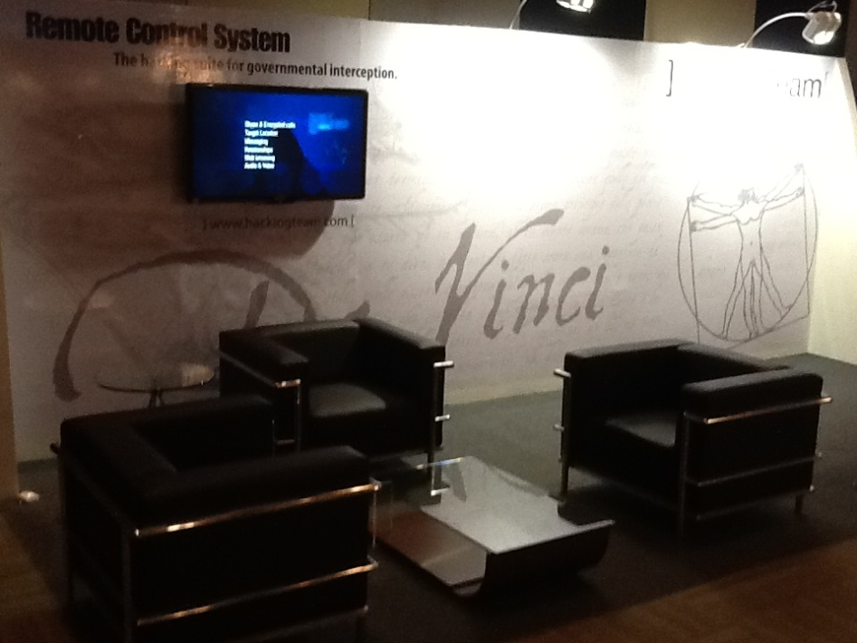
HackingTeam 2012

Slide 5
1Q 2013
2Q 2013
3Q 2013
4Q 2013
Jan
Feb
Mar
Apr
May
Jun
July
Ago
Sep
Oct
Nov
Dec
HTCIA
Nevada
(USA)
Sep. 08
INTERPOL
Cartagena
(Colombia)
Nov. 04
IDEX
Abu Dhabi
(UAE)
Feb.17
ISS
Dubai
(UAE)
Mar. 04
GSA
Suntec
(Singapore)
Apr. 02
IDEC
Moscow
(Russia)
Jun. 03
NATIA
Austin
(USA)
July 13
ISS
Washington
(USA)
Oct. 08
ISS
Kuala
Lumpur
(Malaysia)
Dec. 03
CyberSec Gov
Asia
Kuala Lumpur
(Malaysia)
Jan. 29
(Missing info)
HOSDB
Farnborough
(UK)
Mar. 12
IALEIA
Chicago
(USA)
Apr. 08
ISS
Prague
(Czech Rep)
Jun. 04
ISS
Brasilia
(Brazil)
July 23
MILIPOL
Paris
(France)
Nov. 19
CYBER
INTELLIGENCE
Kuala Lumpur
(Malaysia)
Mar. 12
COUNTER TERROR
Olympia
(UK)
Apr. 24
GPEC
Kuala
Lumpur
(Malaysia)
Jun. 17
MATIA
USA
(Missing info)
CYBER
SECURITY UAE
Dubai
(UAE)
Mar. 18
Confermata
Da valutare
Bocciata

Slide 6
1Q 2013
2Q 2013
3Q 2013
4Q 2013
Jan
Feb
Mar
Apr
May
Jun
July
Ago
Sep
Oct
Nov
Dec
Intersec
Dubai
Jan. 15
LAAD
Brazil
Apr. 09
Tecnicrim
Cuba
Sep. 10
Confermata
Da valutare
Bocciata

Slide 7
North America
IALEIA – Chicago (USA)
HTCIA – Nevada (USA)
NATIA – Austin (USA)
ISS – Washington (USA)
MATIA – (USA)
Europe
HOSDB – Farnborough (UK)
COUNTER TERROR – Olympia (UK)
ISS – Prague (CZECH REP)
MILIPOL – Paris (FRANCE)
Latin Americas
ISS – Brasilia (BRAZIL)
Russia & Asia
CYBERSEC GOV ASIA - Kuala Lumpur (MALAYSIA)
CYBER INTELLIGENCE – Kuala Lumpur (MALAYSIA)
GSA – Suntec (SINGAPORE)
IDEC – Moscow (RUSSIA)
GPEC – Kuala Lumpur (MALAYSIA)
ISS – Kuala Lumpur (MALAYSIA)
Middle East & Africa
IDEX – Abu Dhabi (UAE)
ISS – Dubai (UAE)
CYBER SECURITY – Dubai (UAE)

Slide 8
Cyber Sec – Cyber Security for Government Asia January 29 – 30 Kuala Lumpur - Malaysia
Type |  | Conference + Exhibition
Speech |  | TBC
Exposition Target |  | Governmental + Private Reseller
Exposition Fee |  | € 5.000,00
Exposition costs (Meeting room, Speech, Furniture etc.) |  | € 1.000,00
HT&Extra costs (Transport&Accommodation, Customs etc.) |  | € 1.500,00 (Hotel) € 3.800,00 (Flights)
Stand shipping/construction |  | € 4.000,00 (Nomadic – Shipping)
Website |  | http://www.cybersecurityasia.com/Event.aspx?id=829356
Contacts |  | sponsorship@iqpc.com.sg
HT Team |  | 2 Sales + 1 Field
TOTAL COST |  | € 15.300,00

Slide 9
IDEX February 17– 21 Abu Dhabi - UAE
Type |  | Exhibition
Speech |  | NO
Exposition Target |  | Governmental + Private Reseller
Exposition Fee |  | € 8.500,00
Exposition costs (Meeting room, Speech, Furniture etc.) |  | € 2.000,00
HT&Extra costs (Transport&Accommodation, Customs etc.) |  | € 4.000,00 (Hotel) € 2.500,00 (Flights)
Stand shipping/construction |  | € 2.800,00 (Pon – Shipping)
Website |  | http://www.idexuae.ae/page.cfm/Link=1/t=m/goSection=1
Contacts |  | shahla.karim@adnec.ae
HT Team |  | 2 Sales + 1 Field
TOTAL COST |  | € 19.800,00

Slide 10
ISS – Intelligence Surveillance System EMEA
March 04 - 06 Dubai - UAE
Type |  | Conference + Exhibition
Speech |  | a
Exposition Target |  | Governmental + Private Reseller
Exposition Fee |  | € 11.500,00
Exposition costs (Meeting room, Speech, Furniture etc.) |  | € 1.200,00
HT&Extra costs (Transport&Accommodation, Customs etc.) |  | € 5.200,00 (Hotel) € 4.300,00 (Flights)
Stand shipping/construction |  | € 2.000,00 (Pon – Shipping)
Website |  | http://www.issworldtraining.com/ISS_MEA/
Contacts |  | beaton@telestrategies.com mhrs.dxbae.events2@marriotthotels.com
HT Team |  | 3 Sales + 3 Field
TOTAL COST |  | € 24.200,00

Slide 11
HOSDB - Security & Policing March 12 - 14 Farnborough - UK
Type |  | Exhibition
Speech |  | NO
Exposition Target |  | UK Government event (police, security and National Resilience event)
Exposition Fee |  | € 4.800,00
Exposition costs (Meeting room, Speech, Furniture etc.) |  | € 900,00
HT&Extra costs (Transport&Accommodation, Customs etc.) |  | € 1.600,00 (Hotel) € 900,00 (Flights)
Stand shipping/construction |  | € 450,00 (Nomadic - Shipping)
Website |  | http://www.adsgroup.org.uk/
Contacts |  | carolyn.elster@adsgroup.org.uk chris.higgins@adsgroup.org.uk
Website |  | 2 Sales + 1 Field
TOTAL COST |  | € 8.650,00

Slide 12
Cyber Intelligence Asia March 12 - 15 Kuala Lumpur - Malaysia
Type |  | Exhibition
Speech |  | a
Exposition Target |  | Critical infrastructure, Digital forensics, Threat investigations
Exposition Fee |  | € 9.300,00
Exposition costs (Meeting room, Speech, Furniture etc.) |  | € 1.070,00
HT&Extra costs (Transport&Accommodation, Customs etc.) |  | € 1.500,00 (Hotel) € 3.800,00 (Flights)
Stand shipping/construction |  | € 4.000,00 (Nomadic - Shipping) (Coincide con Farnborough UK)
Website
Contacts |  | laura@intelligence-sec.com
HT Team |  | 2 Sales + 1 Field
TOTAL COST |  | € 19.670,00

Slide 13
Cyber Security UAE March 18 - 19 Dubai - UAE
Type |  | Exhibition
Speech |  | TBC
Exposition Target |  | Governmental + Private Reseller
Exposition Fee |  | € 6.000,00
Exposition costs (Meeting room, Speech, Furniture etc.) |  | € 1.000,00
HT&Extra costs (Transport&Accommodation, Customs etc.) |  | € 750,00 (Hotel) € 2.500,00 (Flights)
Stand shipping/construction |  | € 3.000,00 (Nomadic – check shipping/Singapore office)
Website
Contacts |  | Laura McKenzie lauram@oliverkinross.com
HT Team |  | 1 Sales + 1 Field
TOTAL COST |  | € 13.250,00

Slide 14
GSA – Global Security Asia April 02 - 04 Singapore
Type |  | Exhibition
Speech |  | NO
Exposition Target
Exposition Fee |  | € 7.500,00
Exposition costs (Meeting room, Speech, Furniture etc.) |  | € 1.070,00
HT&Extra costs (Transport&Accommodation, Customs etc.) |  | € 1.500,00 (Hotel) € 3.800,00 (Flights)
Stand shipping/construction |  | € 5.000,00 (Pon - Shipping) (Verificare tempistica da ISS Dubai)
Website |  | www.globalsecasia.com
Contacts |  | globalsecasia@gmail.com fiere@ediconsult.com
HT Team |  | 2 Sales + 1 Field
TOTAL COST |  | € 18.870,00

Slide 15
IALEIA April 08 - 12 Chicago - USA
Type |  | Exhibition
Speech |  | a
Exposition Target |  | Public + Private
Exposition Fee |  | € 4.050,00
Exposition costs (Meeting room, Speech, Furniture etc.)
HT&Extra costs (Transport&Accommodation, Customs etc.) |  | € 1.150,00 (Hotel) € 2.000,00 (Flights)
Stand shipping/construction |  | Nomadic&Roll-up (Velasco)
Website |  | http://www.ialeia.org/images/docs/2013.pdf
Contacts |  | stevenpokotylo@gmail.com radek.ostoja@europol.europa.eu
HT Team |  | 1 Sales + 1 Field
TOTAL COST |  | € 7.200,00

Slide 16
Counter Terror Expo April 24 - 25 London – UK
Type |  | Exhibition
Speech |  | NO
Exposition Target |  | Public + Private
Exposition Fee |  | € 2.500,00
Exposition costs (Meeting room, Speech, Furniture etc.) |  | € 1.150,00
HT&Extra costs (Transport&Accommodation, Customs etc.) |  | € 800,00 (Hotel) € 900,00 (Flights)
Stand shipping/construction |  | € 450,00 (Nomadic - Shipping)
Website |  | http://www.counterterrorexpo.com/
Contacts |  | Wendy.Moore@clarionevents.com lrobertson@showsponsorship.co.uk
HT Team |  | 2 Sales + 1 Field
TOTAL COST |  | € 5.800,00

Slide 17
IDEC XXIX 2012 Exhibition June 03 - 06 Moscow – Russia
Type |  | Exhibition
Speech |  | NO
Exposition Target |  | Anti Narcotics
Exposition Fee |  | € 5.100,00
Exposition costs (Meeting room, Speech, Furniture etc.) |  | € 1.800,00
HT&Extra costs (Transport&Accommodation, Customs etc.) |  | € 2.300,00 (Hotel) € 2.400,00 (Flights)
Stand shipping/construction |  | € 4.000,00 (Pon - Construction)
Website
Contacts |  | idecexpo@hotmail.com losbatistas@hotmail.com
HT Team |  | 2 Sales + 1 Field
TOTAL COST |  | € 15.600,00

Slide 18
ISS – Intelligence Surveillance System Europe June 6 – 7 Prague - Czech Rep.
Type |  | Conference + Exhibition
Speech |  | a
Exposition Target |  | Public + Private
Exposition Fee |  | € 11.500,00
Exposition costs (Meeting room, Speech, Furniture etc.) |  | € 2.000,00
HT&Extra costs (Transport&Accommodation, Customs etc.) |  | € 3.800,00 (Hotel) € 3.400,00 (Flights)
Stand shipping/construction |  | € 2.500,00 (Pon - Shipping)
Website |  | http://www.issworldtraining.com
Contacts |  | beaton@telestrategies.com Bronislava.Kralova@clarion-hotels.cz
HT Team |  | 3 Sales + 3 Field
TOTAL COST |  | € 23.200,00

Slide 19
GPEC - Asia General Police & Special Equipment Exhibition June 17 - 19 Kuala Lumpur - Malaysia
Type |  | Exhibition
Speech |  | NO
Exposition Target |  | Public + Private
Exposition Fee |  | € 9.300,00
Exposition costs (Meeting room, Speech, Furniture etc.) |  | € 1.000,00
HT&Extra costs (Transport&Accommodation, Customs etc.) |  | € 1.500,00 (Hotel) € 3.800,00 (Flights)
Stand shipping/construction |  | € 4.000,00 (Nomadic - Shipping)
Website
Contacts |  | madia@fr-exhibitions.com.my
HT Team |  | 2 Sales + 1 Field
TOTAL COST |  | € 19.600,00

Slide 20
NATIA – 27° Annual Training Conference and Technology Exhibition July 7 -13 Austin - Texas
Type |  | Exposition
Speech |  | NO
Exposition Target |  | Government
Exposition Fee |  | € 1.200,00
Exposition costs (Meeting room, Speech, Furniture etc.)
HT&Extra costs (Transport&Accommodation, Customs etc.) |  | € 900,00 (Hotel) € 1.500,00 (Flights)
Stand shipping/construction |  | Nomadic (Velasco)
Website |  | www.natia.org
Contacts |  | exhibits@natia.org
HT Team |  | 2 Sales + 1 Field
TOTAL COST |  | € 3.600,00

Slide 21
ISS – Intelligence Surveillance System Latin Am. July 26 – 28 Brasilia - Brazil
Type |  | Conference + Exhibition
Speech |  | a
Exposition Target |  | Public + Private
Exposition Fee |  | € 11.500,00
Exposition costs (Meeting room, Speech, Furniture etc.) |  | € 2.500,00
HT&Extra costs (Transport&Accommodation, Customs etc.) |  | € 3.700,00 (Hotel) € 10.000,00 (Flights)
Stand shipping/construction |  | € 4.000,00 (Pon – Construction)
Website |  | http://www.issworldtraining.com/
Contacts |  | beaton@telestrategies.com rtba.operacional5@goldentulip.com.br
HT Team |  | 3 Sales + 3 Field
TOTAL COST |  | € 31.700,00

Slide 22
HTCIA - High Technology Crime Investigation Association September 08 – 11 Nevada - USA
Type |  | Exhibition
Speech |  | NO
Exposition Target |  | Public + Private
Exposition Fee |  | € 4.900,00
Exposition costs (Meeting room, Speech, Furniture etc.) |  | € 400,00
HT&Extra costs (Transport&Accommodation, Customs etc.) |  | € 1.000,00 (Hotel) € 2.000,00 (Flights)
Stand shipping/construction |  | Nomadic Velasco
Website
Contacts |  | carol@htcia.org bbooth@hersheypa.com
HT Team |  | 2 Sales + 1 Field
TOTAL COST |  | € 8.300,00

Slide 23
ISS – Intelligence Surveillance System USA October 10-12 Washington - USA
Type |  | Conference + Exhibition
Speech |  | a
Exposition Target |  | Public + Private
Exposition Fee |  | € 11.500,00
Exposition costs (Meeting room, Speech, Furniture etc.) |  | € 1.700,00
HT&Extra costs (Transport&Accommodation, Customs etc.) |  | € 2.900,00 (Hotel) € 6.500,00 (Flights)
Stand shipping/construction |  | € 5.200,00 (Pon – Shipping)
Website |  | http://www.issworldtraining.com/
Contacts |  | beaton@telestrategies.com
HT Team |  | 3 Sales + 3 Field
TOTAL COST |  | € 27.800,00

Slide 24
INTERPOL – 82th General Assembly November 04 Cartagena - Colombia
Type |  | Conference
Speech |  | NO
Exposition Target |  | Interpol/Police
Exposition Fee |  | € 14.000,00
Exposition costs (Meeting room, Speech, Furniture etc.) |  | € 900,00
HT&Extra costs (Transport&Accommodation, Customs etc.) |  | € 1.800,00 (Hotel) € 3.000,00 (Flights)
Stand shipping/construction |  | Nomadic (Velasco)
Website |  | http://www.interpol.int/en
Contacts
HT Team |  | 3 Sales
TOTAL COST |  | € 19.700,00

Slide 25
Milipol Parigi November 19-22 Parigi - France
Type |  | Exhibition
Speech |  | NO
Exposition Target |  | Public + Private
Exposition Fee |  | € 6.000,00
Exposition costs (Meeting room, Speech, Furniture etc.) |  | € 1.100,00
HT&Extra costs (Transport&Accommodation, Customs etc.) |  | € 3.700,00 (Hotel) € 1.000,00 (Flights)
Stand shipping/construction |  | € 450,00 (Nomadic - Shipping)
Website |  | http://www.milipol.com
Contacts
HT Team |  | 3 Sales + 2 Field
TOTAL COST |  | € 12.250,00

Slide 26
MATIA – Mid Atlantic Chapter Meeting November ? USA
Type |  | Exhibition
Speech |  | NO
Exposition Target |  | Government
Exposition Fee |  | € 370,00
Exposition costs (Meeting room, Speech, Furniture etc.) |  | € 250,00
HT&Extra costs (Transport&Accommodation, Customs etc.) |  | € 180,00 (Hotel)
Stand shipping/construction |  | Nomadic (Velasco)
Website |  | http://www.natia.org
Contacts |  | mavicepresident@natia.org
HT Team |  | 1 Sales
TOTAL COST |  | € 800,00

Slide 27
ISS – Intelligence Surveillance System Far East December 4-6 Kuala Lumpur - Malaysia
Type |  | Conference + Exhibition
Speech |  | a
Exposition Target |  | Public + Private
Exposition Fee |  | € 11.500,00
Exposition costs (Meeting room, Speech, Furniture etc.) |  | € 1.000,00
HT&Extra costs (Transport&Accommodation, Customs etc.) |  | € 2.800,00 (Hotel) € 7.000,00 (Flights)
Stand shipping/construction |  | € 5.000,00 (Spedizione Pon)
Website |  | http://www.issworldtraining.com/
Contacts |  | beaton@telestrategies.com
HT Team |  | 3 Sales + 3 Field
TOTAL COST |  | € 27.300,00

Slide 28
Fairs&Events 2013
TYPE OF COST
Exposition Fee |  | € 99.900,00 | € 46.120,00 | € 146.020,00
Exposition costs |  | € 16.270,00 | € 5.770,00 | € 22.040,00
Stand |  | € 35.400,00 | € 11.450,00 | € 46.850,00
TOTAL COST |  | € 151.570,00 | € 63.340,00 | € 214.910,00
12
8
12
8

