Slide 1
Fairs&Events 2012

Slide 2
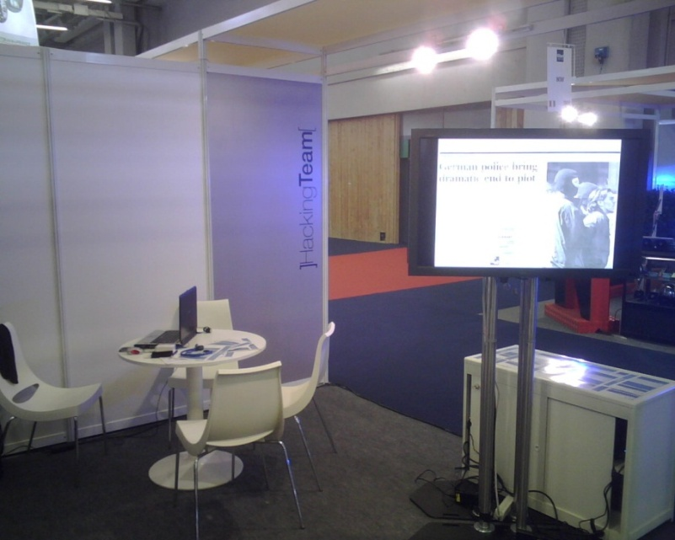
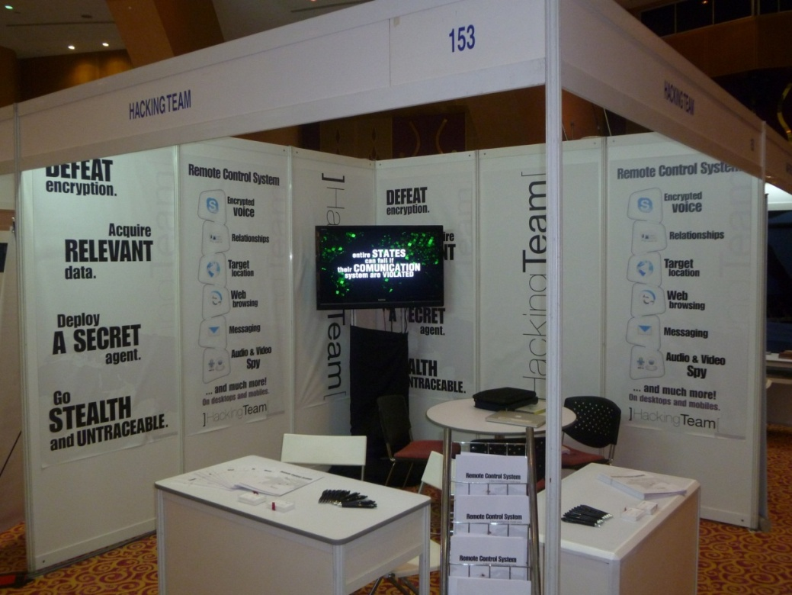
HackingTeam 2007 - 2011

Slide 3
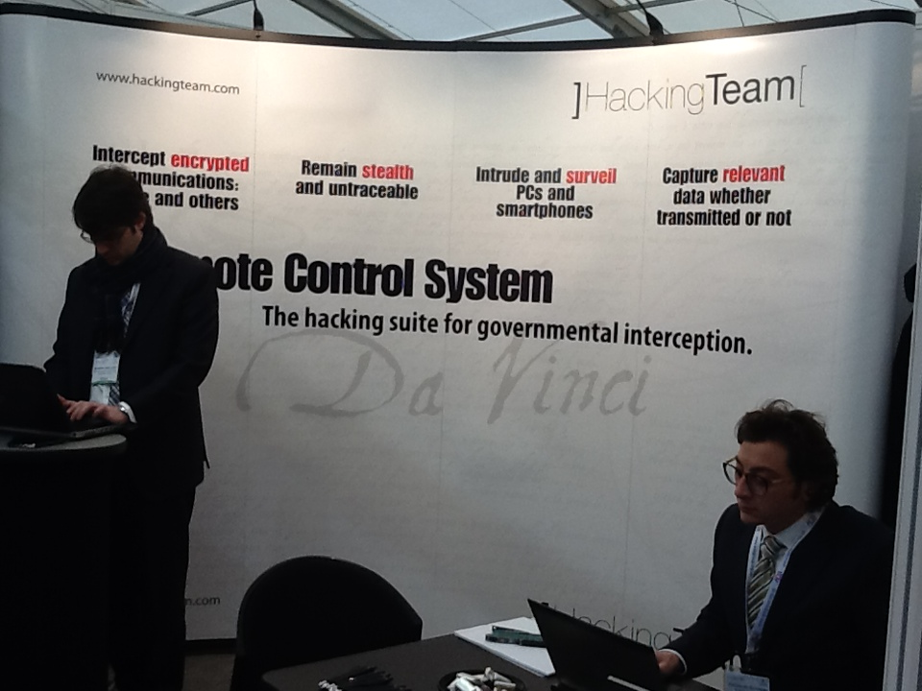
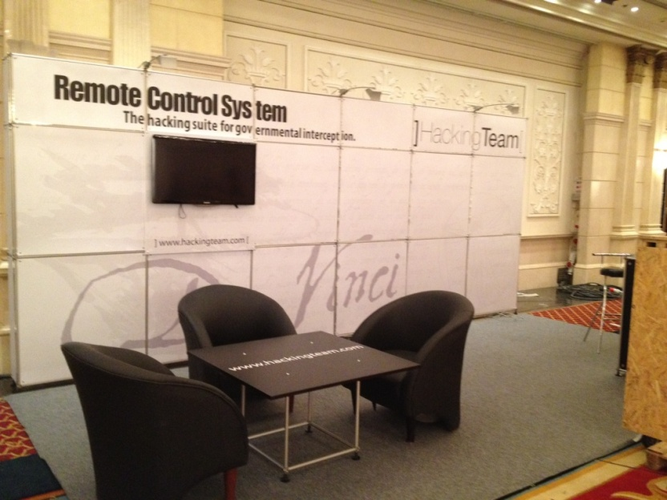
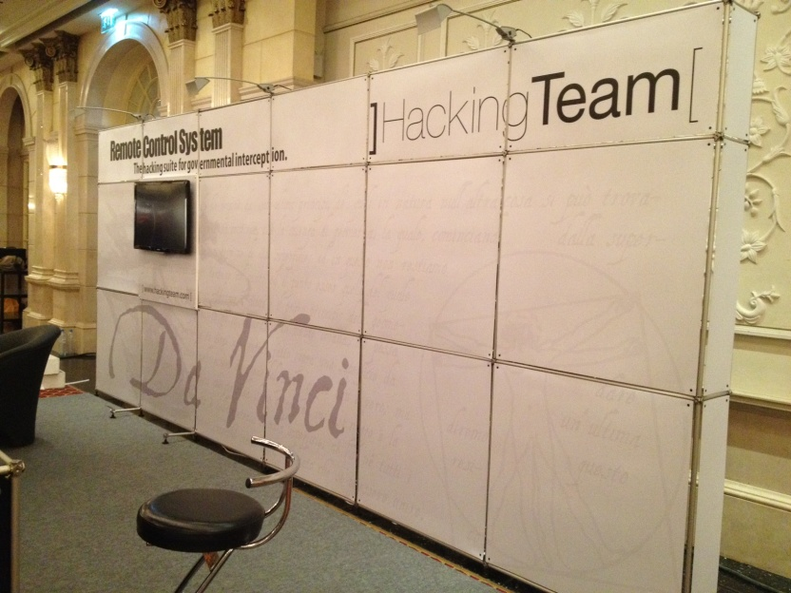
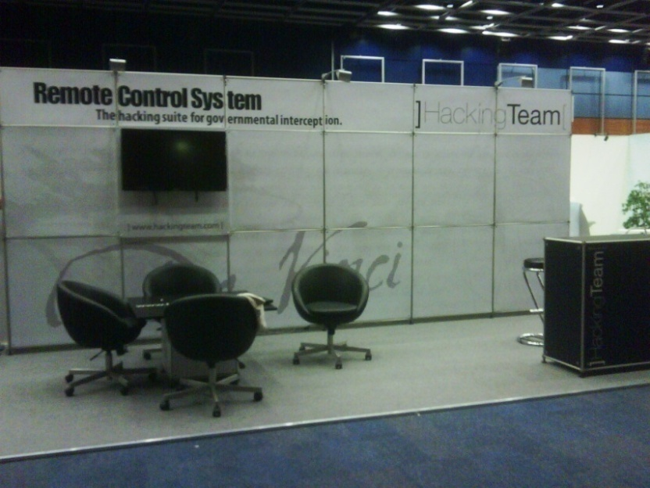
HackingTeam 2012

Slide 4
1Q 2012
2Q 2012
3Q 2012
4Q 2012
Jan
Feb
Mar
Apr
May
Jun
July
Ago
Sep
Oct
Nov
Dec
HOSDB
United Kingdom
Jan 31
LAAD
Brazil
Apr. 10
NATIA
USA
July 07
MILIPOL
Qatar
Oct. 08
ISS
Dubai
Feb. 13
Counter Terror
USA
May. 16
ISS
Brazil
July 26
ISS
USA
Oct. 10
ISS
Prague
Jun. 05
Tecnicrim
Cuba
Sep. 10
HLS
Israel
Nov. 11
IDEC
BALI
Jun. 11
HTCIA
USA
Sep. 16
ISS
Malaysia
Dec. 04
IALEIA
Poland
Sep. 18

Slide 5
North America
COUNTER TERROR – USA May NATIA – USA July
HTCIA – USA Sept
ISS – USA Oct
MATIA – USA Nov
Europe
HOSDB – UK Jan
ISS - Prague Jun
IALEIA – Poland Sept
Russia & Asia
IDEC – Bali June
ISS – Malaysia Dec
Central America
TECNICRIM – Cuba Sep
Middle East & Africa
ISS – Dubai Feb
MILIPOL - Qatar Oct
HLS – Israel Nov
Latin Americas
LAAD – Brazil April ISS – Brazil July

Slide 6
HOSDB - Security & Policing January 31/February 2 Farnborough - UK
a
Tipologia |  | Fiera
Speech |  | NO
Exposition Target |  | UK Government event (police, security and National Resilience event)
Exposition Fee |  | GBP 3.295,00 -> € 4.795,27
Costi Generali (es. HT T&A, customs, ecc) |  | GBP 1.227,01 -> € 1.443,16 (Hotel) € 900,00 (Voli)
Costi Accessori (es. Speech / meeting room) |  | GBP 626,40 -> € 759,49
Website |  | http://www.adsgroup.org.uk/
Contacts: |  | Carolyn.elster@adsgroup.org.uk
HT Team: |  | 2 Sales (MB/ML) + 1 Field (FdG)

Slide 7
ISS – Intelligence Surveillance System EMEA February 13 – 15 Dubai – UAE
a
Tipologia |  | Conferenza + Fiera
Speech |  | a
Exposition Target |  | Governmental + Private Reseller
Exposition Fee |  | USD 14.200,00 -> € 10.857,83
Costi Generali (es. HT T&A, customs, ecc) |  | AED 30.111,00 -> € 6.353,00 (Hotel) € 5.000,00 (Voli)
Costi Accessori (es. Speech / meeting room) |  | USD 1.046,00 -> € 827,00 € 105,00
Website |  | http://www.issworldtraining.com/ISS_MEA/
Contacts: |  | beaton@telestrategies.com mhrs.dxbae.events2@marriotthotels.com
HT Team: |  | 3 Sales (MB+MM+ML) + 3 Field (MV/AO/ AP) + G. Russo
Note: |  | LANCIO di RCS DA VINCI

Slide 8
LAAD Security - International Trade Show for Public, Corporate Security and Law Enforcement April 10-12 Rio de Janerio - Brazil
a
Tipologia |  | Fiera
Speech |  | NO
Exposition Target
Exposition Fee |  | USD 12.145,00 -> € 9.288,00
Costi Generali (es. HT T&A, customs, ecc) |  | BRL 9.849,00 -> € 4.252,00 (Hotel) € 5.800,00 (Voli) € 2230,00 (Costo sdoganamento)
Costi Accessori (es. Speech / meeting room) |  | USD 235,00 -> € 189,91
Website |  | http://www.laadsecurity.com/
Contacts: |  | Thainara.Navascues@clarionevents.com
HT Team: |  | 2 Sales (MB/ML) + 1 Field (FdG)

Slide 9
Counter Terror Expo May 16-17 Washington - USA
a
Tipologia |  | Fiera
Speech |  | NO
Exposition Target
Exposition Fee |  | USD 3.300,00 -> € 2.538,00
Costi Generali (es. HT T&A, customs, ecc) |  | € 600,00 (Hotel) € 1.132,00 (Volo)
Costi Accessori (es. Speech / meeting room) |  | USD 864,80 -> € 681,19 USD 1.020,00 -> € 814,56
Website |  | http://www.counterterrorexpo.com/
Contacts: |  | Wendy.Moore@clarionevents.com
HT Team: |  | 1 Sales (AV) + 1 Field (AP)

Slide 10
ISS – Intelligence Surveillance System Europe June 6 – 7 Prague - Czech Rep.
a
Tipologia |  | Conferenza + Fiera
Speech |  | a
Exposition Target |  | Public + Private
Exposition Fee |  | USD 14.200,00 -> € 10.902,77
Costi Generali (es. HT T&A, customs, ecc) |  | CZK 97.195,25 -> € 3.800,00 (Hotel) € 1139,00 (Hotel) € 7.200,00 (Voli) € 1466,00 (Cocktail) € 2500,00 (Costo spedizione)
Costi Accessori (es. Speech / meeting room) |  | USD 750,00 -> € 570,83 € 1.890,00 (Furniture)
Website |  | http://www.issworldtraining.com
Contacts: |  | beaton@telestrategies.com Bronislava.Kralova@clarion-hotels.cz
HT Team: |  | 3 Sales (MB/ML/MM) + 4 Field (MV/AO/DM/MC) + D. Vincenzetti + G. Russo + L. Rana + F. D’Alessio

Slide 11
IDEC XXIX Exhibition June 11 – 15 Bali - Indonesia
a
Tipologia |  | Fiera
Speech |  | a
Exposition Target |  | Public + Private
Exposition Fee |  | USD 6.560,00 -> € 5.064,08
Costi Generali (es. HT T&A, customs, ecc) |  | USD 3.890,00 -> € 3.078,77 (Hotel) € 5.400,00 (Voli)
Costi Accessori (es. Speech / meeting room) |  | USD 310,00 -> € 255,64 (Pass partner) USD 330,00 -> € 277,50
Website
Contacts: |  | idecexpo@hotmail.com losbatistas@hotmail.com
HT Team: |  | 2 Sales (MB/AV) + 1 Field (AS)

Slide 12
NATIA – 27° Annual Training Conference and Technology Exhibition July 7 -13 Austin - Texas
a
Tipologia |  | Exposition
Speech |  | NO
Exposition Target
Exposition Fee |  | USD 1.500,00 -> € 1.210,00
Costi Generali (es. HT T&A, customs, ecc) |  | USD 1.117,80 -> € 909,87 (Hotel) € 936,00 (Volo)
Costi Accessori (es. Speech / meeting room)
Website |  | www.natia.org
Contacts: |  | exhibits@natia.org
HT Team: |  | 1 Sales (AV) + 1 Field (AP)
Note: |  | Presenza con CICOM USA

Slide 13
ISS – Intelligence Surveillance System Latin Am. July 26 – 28 Brasilia - Brazil
a
Tipologia |  | Conferenza + Fiera
Speech |  | a
Exposition Target |  | Public + Private
Exposition Fee |  | USD 14.200,00 -> € 11.486,00
Costi Generali (es. HT T&A, customs, ecc) |  | R$ 9.625,50 -> € 3.775,10 (Hotel) € 16.000,00 (Voli)
Costi Accessori (es. Speech / meeting room) |  | USD 745,20 -> € 621,67 USD 4.100,00 -> € 3.386,90 (Costruzione Pon) € 130,00 (Coupon) R$ 4.400,00 -> € 1.752,36 (Internet)
Website |  | http://www.issworldtraining.com/
Contacts: |  | beaton@telestrategies.com rtba.operacional5@goldentulip.com.br
HT Team: |  | 3 Sales (MB/ML/AV) + 4 Field (MV/AO/)

Slide 14
EXPO Tecnicrim September 10 – 13 La Havana -Cuba
a
Tipologia |  | Fiera
Speech |  | NO
Exposition Target |  | Public + Private
Exposition Fee |  | CUC 1.420,00 -> € 1.234,00 (Fee+Furniture)
Costi Generali (es. HT T&A, customs, ecc) |  | € 1.051,00 (Hotel) USD 353,13 -> € 286,00 (Hotel Mexico Velasco) € 1.400,00 (Voli)
Costi Accessori (es. Speech / meeting room)
Website
Contacts: |  | raulg@palco.cu angel@palco.cu teccrim@mn.mn.co.cu
HT Team: |  | 1 Sales (AV) + 1 Field (AP/)

Slide 15
HTCIA - High Technology Crime Investigation Association September 16 – 19 Hershey - USA
a
Tipologia |  | Fiera
Speech |  | NO
Exposition Target |  | Public + Private
Exposition Fee |  | USD 6.050,00 -> € 4.900,00
Costi Generali (es. HT T&A, customs, ecc) |  | USD 1.198,80 -> € 989,73 (Hotel)
Costi Accessori (es. Speech / meeting room) |  | USD 502,12 -> € 399,24 (Sedie+Tavolo)
Website |  | http://www.htcia.org
Contacts: |  | carol@htcia.org bbooth@hersheypa.com
HT Team: |  | 1 Sales (AV) + 1 Field (AP)

Slide 16
IALEIA September 17 – 20 Legionowo - Poland
a
Tipologia |  | Fiera
Speech |  | NO
Exposition Target |  | Public + Private
Exposition Fee |  | USD 5.000,00 -> € 4.050,00
Costi Generali (es. HT T&A, customs, ecc) |  | € 400,00 (Hotel) € 300,00 (Voli)
Costi Accessori (es. Speech / meeting room)
Website |  | http://www.ialeia.org/training-and-certification/conference/2012-06-21-18-07-40.html
Contacts: |  | stevenpokotylo@gmail.com radek.ostoja@europol.europa.eu
HT Team: |  | 1 Sales (ML) + 1 Field (FB)

Slide 17
Milipol Qatar October 08 – 10 Doha - Qatar
a
Tipologia |  | Fiera
Speech
Exposition Target |  | Public + Private
Exposition Fee |  | € 7.945,00
Costi Generali (es. HT T&A, customs, ecc) |  | QAR 18.130,00 -> € 3.954,29 (Hotel) € 2.800,00 (Voli) QAR 450,00 -> € 96,00 (Servizio transfer) € 3.140,00 (Spedizione Nomadic)
Costi Accessori (es. Speech / meeting room) |  | USD 772,00 -> € 590,00 (Sedia,sgabello, rack, TV) QAR 250,00 -> € 50,00 (Internet)
Website |  | http://www.milipolqatar.com
Contacts: |  | Fatima.FELLAH@comexposium.com Thi-My.DANG@comexposium.com milipol@ediconsult.com
HT Team: |  | 2 Sales (MB/MM) + 2 Field (DM/SY)

Slide 18
ISS – Intelligence Surveillance System USA October 10-12 Washington - USA
a
Tipologia |  | Conferenza + Fiera
Speech |  | a
Exposition Target |  | Public + Private
Exposition Fee |  | USD 14.200,00 -> € 11.500,00
Costi Generali (es. HT T&A, customs, ecc) |  | USD 5.443,21 -> € 4.200,00 (Hotel) € 6.500,00 (Voli) € 5.800,00 (Spedizione Pon)
Costi Accessori (es. Speech / meeting room) |  | USD 375,00 -> € 295,00 (Internet) € 120,00 (Flyers) USD 1.729,17 -> € 1.319,00 (Sedie+Sgabello+Rack)
Website |  | http://www.issworldtraining.com/
Contacts: |  | beaton@telestrategies.com
HT Team: |  | 2 Sales (ML/AV) + 3 Field (MV/AO/AP) + G. Russo

Slide 19
MATIA (Mid-Atlantic Chapter Meeting) November 06-08 Cambridge - USA
a
Tipologia |  | Exposition
Speech |  | NO
Exposition Target
Exposition Fee |  | USD 475,00 -> € 370,00
Costi Generali (es. HT T&A, customs, ecc) |  | USD 210,00 -> € 170,00 (Hotel)
Costi Accessori (es. Speech / meeting room) |  | USD 300,80 -> € 235,00 (Power&Internet)
Website |  | http://www.natia.org
Contacts: |  | mavicepresident@natia.org
HT Team: |  | 1 Sales (AV)

Slide 20
Israel HLS November 11 - 14 Israel
Tipologia |  | Fiera
Speech |  | a
Exposition Target |  | Public + Private
Exposition Fee |  | USD 450,00 -> € 350,00
Costi Generali (es. HT T&A, customs, ecc) |  | USD 3.000,00 -> € 2.300,00 (Hotel) € 2.000,00 (Voli) € 3.140,00 (Spedizione Nomadic) (Verificare tempistica ritorno da Qatar)
Costi Accessori (es. Speech / meeting room) |  | USD 1.000,00 -> € 760,00
Website |  | http://www.israelhls2012.com/home.ehtml
Contacts: |  | meitalk@export.gov.il (Ms. Meital Kuperman )
HT Team: |  | 3 Sales + 1 Field

Slide 21
ISS – Intelligence Surveillance System Far East December 11-13 Kuala Lumpur
a
Tipologia |  | Conferenza + Fiera
Speech |  | a
Exposition Target |  | Public + Private
Exposition Fee |  | USD 14.200,00 -> € 11.500,00
Costi Generali (es. HT T&A, customs, ecc) |  | MYR 11.740,00 -> € 2.800,00 (Hotel) € 7.000,00 (Voli) € 4.500,00 (Costruzione Pon)
Costi Accessori (es. Speech / meeting room) |  | USD 1.354,00 -> € 1.020,00
Website |  | http://www.issworldtraining.com/
Contacts: |  | beaton@telestrategies.com
HT Team: |  | 3 Sales + 3 Field

