Slide 1
FAE Group Delivery Guide
VERSION 1.0

Slide 2
Remote Control System Delivery
The FAE Group Delivery Guide aims to provide a simple and comprehensive list of steps to be verified/executed before each product delivery, by the FAE persons involved.
To prepare a new product installation in the proper way, please check all the contents within this guide and check for updates at the following position on FAE DiskStation:
[ 2. DELIVERY ]

Slide 3
1. Technical Requirements
Make sure that the customer correctly received the most updated Technical Requirements document from Sales and get in touch with customer/partner technical department to verify that everything is ready on delivery site.
You can find the most up-to-date Technical Requirements document at the following position:
[ 2. DELIVERY \ 2.1. Technical Requirements (document) ]

Slide 4
2. Technical Guides
Technical Guides are very useful for systems preparation and configurations, to be executed in advance by customer or partner technical staff.
These guides can be extremely useful to FAEs too, once on-site.
You can find Technical Guides documents at the following position:
[ 2. DELIVERY \ 2.2. Technical Guides (documents) ]

Slide 5
3. Software - Release
The Release Software represents the entire set of packages needed to install and configure all the systems belonging to customer's architecture and all the modules chosen within the product license.
You can find Release Software at the following position:
[ 2. DELIVERY \ 2.3. Software (releases) ]

Slide 6
4. Software - Extra
The Extra Software is a set of third party packages needed to ensure the proper functioning of product modules.
You can find the Extra Software at the following position:
[ 2. DELIVERY \ 2.4. Software (extras) ]

Slide 7
5. Product Training
The Product Training document of consists of 11 sections that aim to provide the minimum and mandatory information for the proper use of RCS Galileo.
This training is intended to be performed on-site, during delivery days.
According to client’s product license, one or more sections of this training may be not available for client’s installation.
You can find the most up-to-date Product Training document at the following position:
[ 2. DELIVERY \ 2.5. Product Training (document) ]

Slide 8
6. Delivery Acceptance Procedure
The Delivery Acceptance Procedure document contains a comprehensive set of tests to be performed at the end of delivery, in order to agree with the customer that the entire installation is properly configured and running.
This procedure is NOT mandatory and should NOT be considered neither used or shared with the customer/partner without confirmation from Sales.
You can find the most up-to-date Delivery Acceptance Procedure document at the following position:
[ 2. DELIVERY \ 2.6. Delivery Acceptance Procedure (document) ]

Slide 9
7. Delivery Certificate
The Delivery Certificate is a one-sheet-document that confirms the acceptance of the installation by the customer.
This document needs to be signed and stamped directly from the customer (NOT the partner) before leaving the delivery site. It is extremely important in order to allow Hacking Team to start the maintenance services.
You can find the most up-to-date Delivery Certificate model at the following position:
[ 2. DELIVERY \ 2.7. Delivery Certificate (model) ]
IMPORTANT: this model need to be filled with customer's license information before customer’s sign and stamp.

Slide 10
Before to leave…
Some specific and mandatory activities need to be performed with Hacking Team HQ before to leave for delivery.
Hacking Team Box, DVDs and USB Key
HASP Tokens
License File
Support Portal Certificate
Optional Modules Hardware
Please check how to manage the list above in the proper way using the next slides.

Slide 11
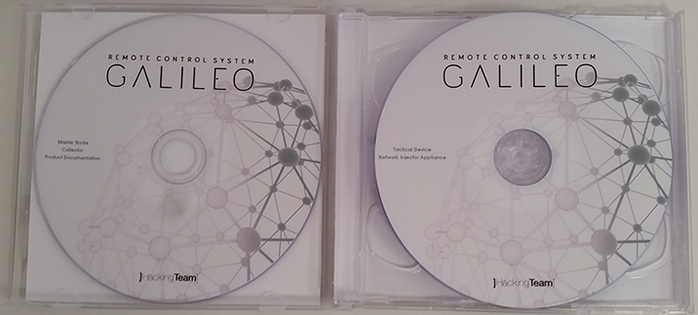
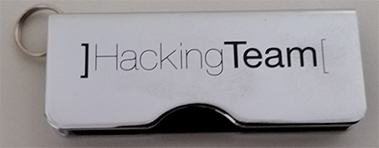
A. Hacking Team Box, DVDs and USB Key
Make sure to prepare a new Hacking Team white box with the following contents:
DVD “Master Node - Collector - Product Documentation": burn the last RCS installers available (Product, Console and Exploits / if licensed) plus documentation (english language)
DVD "Tactical Device - Network Injector Appliance": burn the last Network Injector .ISO file available (only if TNI or NIA is included in customer’s license)
USB key: make a copy of the exact contents at points i. and ii., plus License File (slide C.) and Support Portal Certificate (slide D.)

Slide 12
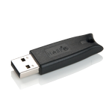
B. HASP Tokens
Two different USB dongles need to be prepared and assigned from HT HQ.
Make sure to bring these tokens with you, or no installation can be performed, since the license file will not match.
For security reasons, never keep the two HASP token within the Hacking Team box (point A) while travelling.

Slide 13
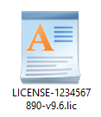
C. License File
Ask for customer's codename and connect to HT License Manager web site, in order to download the license file, from the following URL (Milan’s local network or VPN):
https://licensing.hackingteam.local
Make sure to download the right license file, for the latest RCS release available.

Slide 14
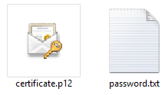
D. Support Portal Certificate
A dedicated .P12 file (+ password) needs to be assigned from HT HQ, in order to allow the customer to connect to Support Portal.
This file will need to be installed on EACH customer's client that will need to connect to the Support Portal.
In order to activate the login on the Support Portal, at least one email address needs to be provided by the customer.

Slide 15
E. Optional Modules Hardware
Verify if part of the equipment listed below need to travel with you at the customer's site:
RMI (Remote Mobile Infection): Zadako Zadacom 3G+ USB Modem
TNI (Tactical Network Injector): rugged bag with full internal hardware set

