Slide 1

Fairs&Events 2013

Slide 2
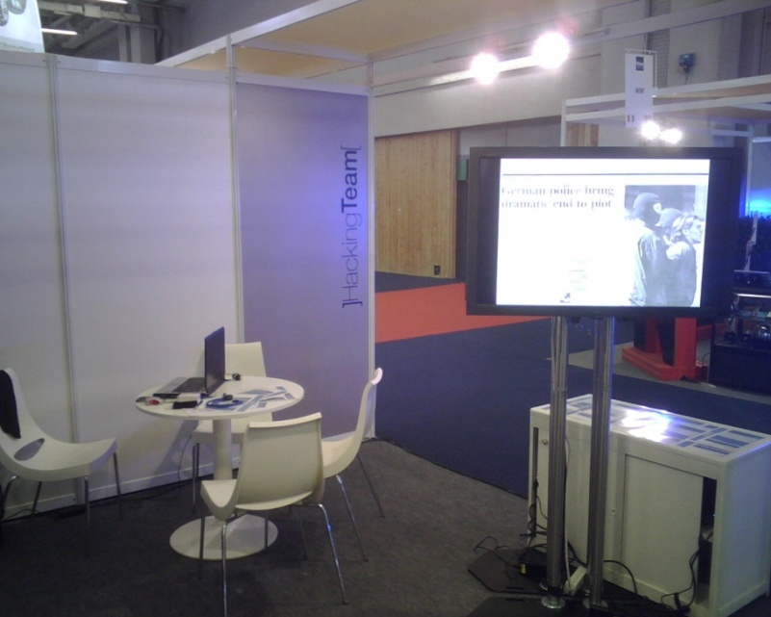
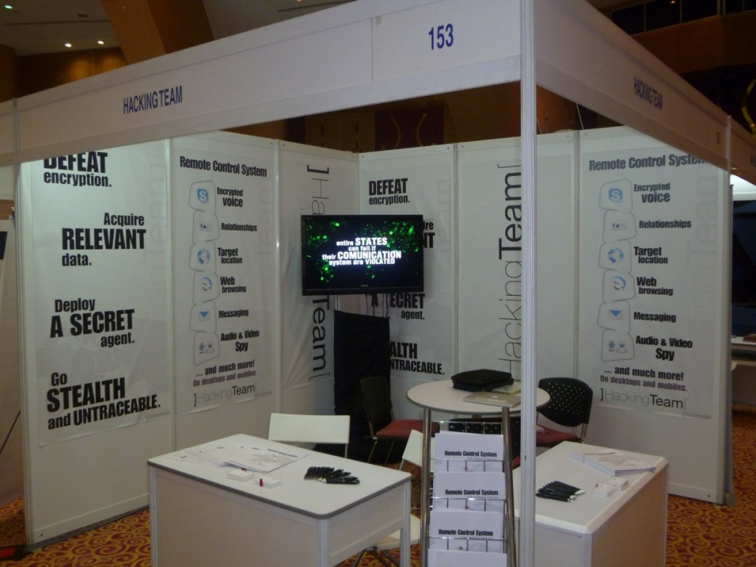
HackingTeam 2007 - 2011

Slide 3
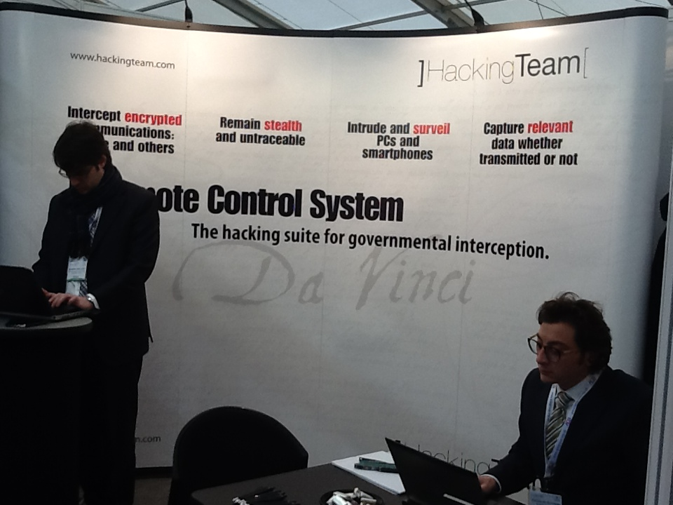
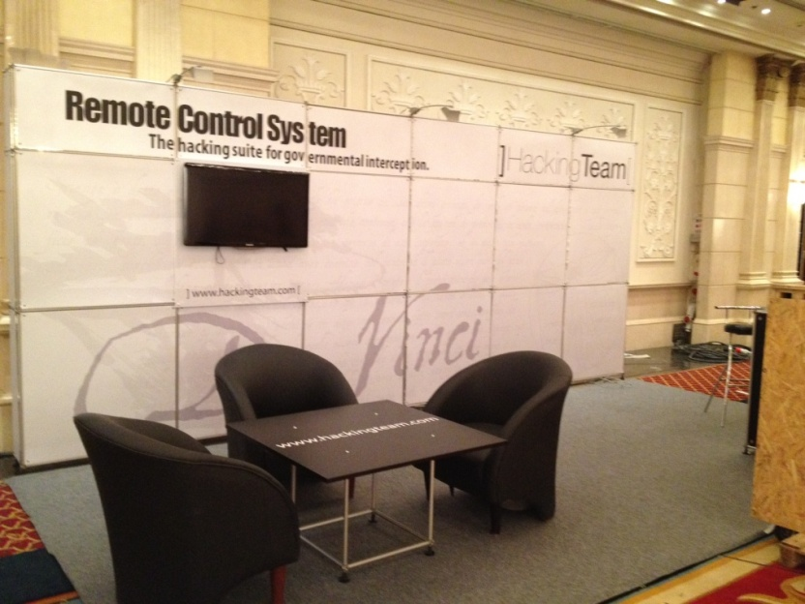
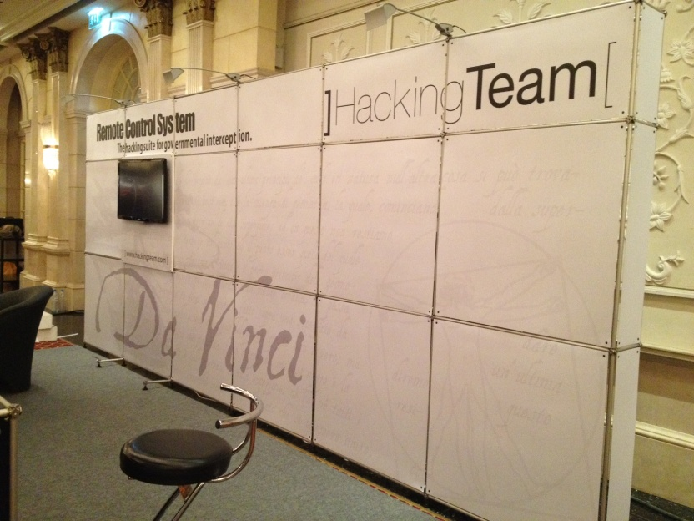
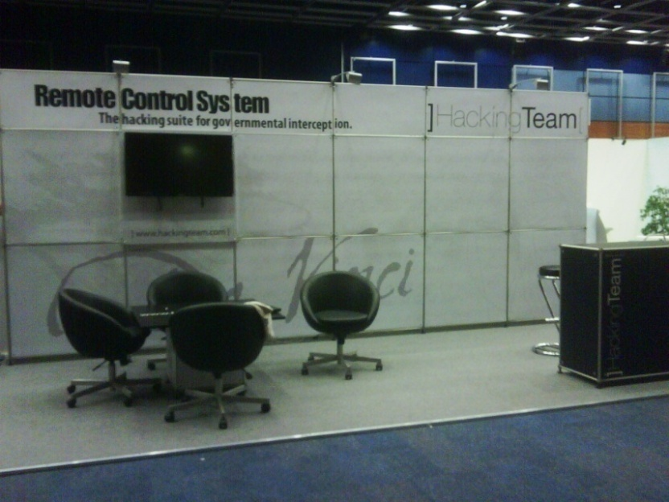
HackingTeam 2012 - 2013

Slide 4
1Q 2013
2Q 2013
3Q 2013
4Q 2013
Jan
Feb
Mar
Apr
May
Jun
July
Ago
Sep
Oct
Nov
Dec
NATIA
USA
July 13
Tecnicrim
Cuba
Sep. 10
MILIPOL
Parigi
Nov. 19
GODA
Oman
Jan. 08
ISS
Dubai
Mar. 04
GSA
Malaysia
Apr. 02
IDEC
Russia
Jun. 03
ISS
Brazil
July 23
HTCIA
Las Vegas USA
Sep. 16
ISS
USA
Oct. 08
HOSDB
United
Kingdom
Mar. 12
IALEIA
Chicago
Apr. 08
ISS
Prague
Jun. 04
Cyber
Intelligence
Malaysia
Mar. 12
LAAD
Brazil
Apr. 09
GPEC
Malaysia
Jun. 17
ISS
Malaysia
Dec. 03
Counter Terror
United Kingdom
Apr. 24

Slide 5
North America
IALEIA – USA Apr
HTCIA – USA Sept
NATIA – USA July
ISS – USA Oct
MATIA – USA Nov
Europe
HOSDB – UK Mar
COUNTER TERROR – UK Apr
ISS - Prague Jun
MILIPOL – France Nov
Central America
TECNICRIM – Cuba Sept
Russia & Asia
CYBER INTELLIGENCE – Malaysia Mar
GSA – Malaysia Apr
IDEC – Russia Jun
GPEC – Malaysia Jun
ISS – Malaysia Dec
Latin Americas
LAAD – Brazil Apr
ISS - Brazil July
Middle East & Africa
GODA – Oman Jan
ISS – Dubai Mar
HLS – Israel Nov

Slide 6
GODA – Gulf of Oman Defense and Aerospace
Exhibition & Conference
January 08 - 10 Muscat - Oman
Tipologia |  | Conferenza + Fiera
Speech |  | NO
Exposition Target |  | Governmental + Private Reseller
Exposition Fee |  | Listino non ancora pubblicato
Costi Generali (es. HT T&A, customs, ecc) |  | USD 950,00 -> € 730,00 (Hotel) € 2.400,00 (Voli) € 3.200,00 (Spedizione Nomadic)
Costi Accessori (es. Speech / meeting room) |  | USD 1.000,00 -> € 760,00
Website |  | www.OmanDefense.com
Contacts: |  | OmanDefense@tntexpo.com mhrs.dxbae.events2@marriotthotels.com
HT Team: |  | 1 Sales + 1 Field

Slide 7
ISS – Intelligence Surveillance System EMEA
March 04 - 06 Dubai - UAE
a
Tipologia |  | Conferenza + Fiera
Speech |  | a
Exposition Target |  | Governmental + Private Reseller
Exposition Fee |  | USD 14.200,00 -> € 10.800,00
Costi Generali (es. HT T&A, customs, ecc) |  | AED 25.000,00 -> € 5.200,00 (Hotel) € 4.300,00 (Voli) € 4.000,00 (Spedizione Pon)
Costi Accessori (es. Speech / meeting room) |  | USD 1.200,00 -> € 920,00
Website |  | http://www.issworldtraining.com/ISS_MEA/
Contacts: |  | beaton@telestrategies.com mhrs.dxbae.events2@marriotthotels.com
HT Team: |  | 3 Sales + 3 Field

Slide 8
HOSDB - Security & Policing
March 12 - 14 Farnborough - UK
Tipologia |  | Fiera
Speech |  | NO
Exposition Target |  | UK Government event (police, security and National Resilience event)
Exposition Fee |  | GBP 3.295,00 -> € 4.800,00
Costi Generali (es. HT T&A, customs, ecc) |  | GBP 1.300,00 -> € 1.600,00 (Hotel) € 900,00 (Voli) € 450,00 (Spedizione Nomadic)
Costi Accessori (es. Speech / meeting room) |  | GBP 700,00 -> € 860,00
Website |  | http://www.adsgroup.org.uk/
Contacts: |  | carolyn.elster@adsgroup.org.uk chris.higgins@adsgroup.org.uk
HT Team: |  | 2 Sales + 1 Field

Slide 9
Cyber Intelligence Asia
March 12 - 15 Kuala Lumpur - Malaysia
Tipologia |  | Fiera
Speech |  | a
Exposition Target
Exposition Fee |  | USD 12.000,00 -> € 9.300,00
Costi Generali (es. HT T&A, customs, ecc) |  | MYR 6.000,00 -> € 1.500,00 (Hotel) € 3.800,00 (Voli) € 3.000,00 (Spedizione Nomadic) (Coincide con Farnborough UK)
Costi Accessori (es. Speech / meeting room) |  | USD 1.400,00 -> € 1.070,00
Website
Contacts: |  | laura@intelligence-sec.com
HT Team: |  | 2 Sales + 1 Field

Slide 10
GSA – Global Security Asia
April 02 - 04 Kuala Lumpur - Malaysia
a
Tipologia |  | Fiera
Speech |  | NO
Exposition Target
Exposition Fee |  | SGD 11.905,00 -> € 7.500,00
Costi Generali (es. HT T&A, customs, ecc) |  | MYR 6.000,00 -> € 1.500,00 (Hotel) € 3.800,00 (Voli) € 4.500,00 (Spedizione Pon) (Verificare tempistica da ISS Dubai)
Costi Accessori (es. Speech / meeting room) |  | USD 1.400,00 -> € 1.070,00
Website |  | www.globalsecasia.com
Contacts: |  | globalsecasia@gmail.com haiyen@globalsecasia.com fiere@ediconsult.com
HT Team: |  | 2 Sales + 1 Field

Slide 11
IALEIA
April 08 - 12 Chicago - USA
Tipologia |  | Fiera
Speech |  | a
Exposition Target |  | Public + Private
Exposition Fee |  | USD 5.000,00 -> € 4.050,00
Costi Generali (es. HT T&A, customs, ecc) |  | USD 1.500,00 -> € 1.150,00 (Hotel) € 2.000,00 (Voli) Nomadic Velasco/Roll up
Costi Accessori (es. Speech / meeting room)
Website |  | http://www.ialeia.org/images/docs/2013.pdf
Contacts: |  | stevenpokotylo@gmail.com radek.ostoja@europol.europa.eu
HT Team: |  | 1 Sales + 1 Field

Slide 12
LAAD - Defence and Security International Exhibition
April 09 - 12 Rio de Janeiro - Brazil
Tipologia |  | Fiera
Speech |  | NO
Exposition Target
Exposition Fee |  | USD 12.145,00 -> € 9.300,00
Costi Generali (es. HT T&A, customs, ecc) |  | BRL 9.800,00 -> € 4.300,00 (Hotel) € 5.800,00 (Voli) Nomadic Velasco
Costi Accessori (es. Speech / meeting room) |  | USD 300,00 -> € 230,00
Website |  | http://www.laadsecurity.com/
Contacts: |  | Thainara.Navascues@clarionevents.com
HT Team: |  | 2 Sales + 1 Field

Slide 13
Counter Terror Expo
April 24 - 25 London – UK
Tipologia |  | Fiera
Speech |  | NO
Exposition Target
Exposition Fee |  | USD 3.300,00 -> € 2.500,00
Costi Generali (es. HT T&A, customs, ecc) |  | GBP 670,00 -> € 830,00 (Hotel) € 900,00 (Voli) € 450,00 (Spedizione Nomadic)
Costi Accessori (es. Speech / meeting room) |  | USD 1.500,00 -> € 1.150,00
Website |  | http://www.counterterrorexpo.com/
Contacts: |  | Wendy.Moore@clarionevents.com lrobertson@showsponsorship.co.uk
HT Team: |  | 2 Sales + 1 Field

Slide 14
IDEC XXIX 2012 Exhibition
June 03 - 07 Moscow – Russia
Tipologia |  | Fiera
Speech |  | NO
Exposition Target |  | Public + Private
Exposition Fee |  | USD 6.600,00 -> € 5.100,00
Costi Generali (es. HT T&A, customs, ecc) |  | USD 3.000,00 -> € 2.300,00 (Hotel) € 2.400,00 (Voli) € 4.000,00 (Costruzione Pon on-site)
Costi Accessori (es. Speech / meeting room) |  | USD 5.000,00 -> € 3.800,00 (Furniture + Shipping)
Website
Contacts: |  | idecexpo@hotmail.com losbatistas@hotmail.com
HT Team: |  | 2 Sales + 1 Field

Slide 15
ISS – Intelligence Surveillance System Europe
June 6 – 7 Prague - Czech Rep.
a
Tipologia |  | Conferenza + Fiera
Speech |  | a
Exposition Target |  | Public + Private
Exposition Fee |  | USD 14.200,00 -> € 10.902,77
Costi Generali (es. HT T&A, customs, ecc) |  | CZK 97.195,25 -> € 3.800,00 (Hotel) € 3.400,00 (Voli) € 2.500,00 (Spedizione Pon)
Costi Accessori (es. Speech / meeting room) |  | € 4.500,00 (Furniture + Shipping)
Website |  | http://www.issworldtraining.com
Contacts: |  | beaton@telestrategies.com Bronislava.Kralova@clarion-hotels.cz
HT Team: |  | 3 Sales + 3 Field

Slide 16
GPEC
June 17 - 19 Kuala Lumpur - Malaysia
Tipologia |  | Fiera
Speech |  | NO
Exposition Target
Exposition Fee |  | USD 12.000,00 -> € 9.300,00
Costi Generali (es. HT T&A, customs, ecc) |  | MYR 6.000,00 -> € 1.500,00 (Hotel) € 3.800,00 (Voli) € 3.200,00 (Spedizione Nomadic)
Costi Accessori (es. Speech / meeting room) |  | USD 1.400,00 -> € 1.070,00
Website
Contacts: |  | laura@intelligence-sec.com
HT Team: |  | 2 Sales + 1 Field

Slide 17
NATIA – 27° Annual Training Conference and Technology Exhibition
July 7 -13 Austin - Texas
Tipologia |  | Exposition
Speech |  | NO
Exposition Target
Exposition Fee |  | USD 1.500,00 -> € 1.210,00
Costi Generali (es. HT T&A, customs, ecc) |  | USD 1.117,80 -> € 909,87 (Hotel) € 1.500,00 (Voli) Nomadic Velasco
Costi Accessori (es. Speech / meeting room)
Website |  | www.natia.org
Contacts: |  | exhibits@natia.org
HT Team: |  | 2 Sales + 1 Field
Note: |  | Presenza con CICOM USA

Slide 18
ISS – Intelligence Surveillance System Latin Am.
July 26 – 28 Brasilia - Brazil
a
Tipologia |  | Conferenza + Fiera
Speech |  | a
Exposition Target |  | Public + Private
Exposition Fee |  | USD 14.200,00 -> € 11.486,00
Costi Generali (es. HT T&A, customs, ecc) |  | R$ 9.625,50 -> € 3.775,10 (Hotel) € 10.000,00 (Voli) € 4.000,00 (Costruzione PON on-site)
Costi Accessori (es. Speech / meeting room) |  | USD 745,20 -> € 621,67 USD 4.100,00 -> € 3.386,90 (Costruzione Pon) € 130,00 (Coupon) R$ 4.400,00 -> € 1.752,36 (Internet)
Website |  | http://www.issworldtraining.com/
Contacts: |  | beaton@telestrategies.com rtba.operacional5@goldentulip.com.br
HT Team: |  | 3 Sales + 3 Field

Slide 19
EXPO Tecnicrim
September 10 – 13 Cuba
Tipologia |  | Fiera
Speech |  | NO
Exposition Target |  | Public + Private
Exposition Fee |  | CUC 1.420,00 -> € 1.234,00
Costi Generali (es. HT T&A, customs, ecc) |  | € 1.051,00 (Hotel) USD 353,13 -> € 286,00 (Hotel Mexico Velasco) € 1.400,00 (Voli) Roll up
Costi Accessori (es. Speech / meeting room)
Website
Contacts: |  | raulg@palco.cu angel@palco.cu teccrim@mn.mn.co.cu
HT Team: |  | 1 Sales + 1 Field

Slide 20
HTCIA - High Technology Crime Investigation Association
September 16 – 19 Las Vegas - USA
Tipologia |  | Fiera
Speech |  | NO
Exposition Target |  | Public + Private
Exposition Fee |  | USD 6.050,00 -> € 4.900,00
Costi Generali (es. HT T&A, customs, ecc) |  | USD 1.198,80 -> € 989,73 (Hotel) Nomadic Velasco
Costi Accessori (es. Speech / meeting room) |  | USD 502,12 -> € 399,24 (Sedie+Tavolo)
Website
Contacts: |  | carol@htcia.org bbooth@hersheypa.com
HT Team: |  | 2 Sales + 1 Field

Slide 21
ISS – Intelligence Surveillance System USA
October 10-12 Washington - USA
a
Tipologia |  | Conferenza + Fiera
Speech |  | a
Exposition Target |  | Public + Private
Exposition Fee |  | USD 14.200,00 -> € 11.500,00
Costi Generali (es. HT T&A, customs, ecc) |  | USD 3.822,79 -> € 2.974,00 (Hotel) € 6.500,00 (Voli) € 5.200,00 (Spedizione Pon)
Costi Accessori (es. Speech / meeting room) |  | USD 375,00 -> € 295,00 (Internet) € 120,00 (Flyers) USD 1.729,17 -> € 1.319,00 (Sedie+Sgabello+Rack)
Website |  | http://www.issworldtraining.com/
Contacts: |  | beaton@telestrategies.com
HT Team: |  | 3 Sales + 3 Field

Slide 22
MATIA (Mid-Atlantic Chapter Meeting)
November 06 - 08 Cambridge - USA
a
Tipologia |  | Exposition
Speech |  | NO
Exposition Target
Exposition Fee |  | USD 475,00 -> € 370,00
Costi Generali (es. HT T&A, customs, ecc) |  | USD 210,00 -> € 170,00 (Hotel)
Costi Accessori (es. Speech / meeting room) |  | USD 300,80 -> € 235,00 (Power&Internet)
Website |  | http://www.natia.org
Contacts: |  | mavicepresident@natia.org
HT Team: |  | 1 Sales (AV)

Slide 23
Milipol Parigi
November 19-22 Parigi - France
Tipologia |  | Fiera
Speech |  | NO
Exposition Target |  | Public + Private
Exposition Fee |  | € 6.000,00
Costi Generali (es. HT T&A, customs, ecc) |  | € 3.700,00 (Hotel) € 1.020,00 (Voli) € 450,00 (Spedizione Nomadic)
Costi Accessori (es. Speech / meeting room) |  | € 1.500,00 (Spedizione + furniture)
Website |  | http://www.milipol.com
Contacts:
HT Team: |  | 3 Sales + 2 Field

Slide 24
ISS – Intelligence Surveillance System Far East
December 4-6 Kuala Lumpur - Malaysia
a
Tipologia |  | Conferenza + Fiera
Speech |  | a
Exposition Target |  | Public + Private
Exposition Fee |  | USD 14.200,00 -> € 11.500,00
Costi Generali (es. HT T&A, customs, ecc) |  | MYR 11.740,00 -> € 2.800,00 (Hotel) € 7.000,00 (Voli) € 4.500,00 (Costruzione Pon)
Costi Accessori (es. Speech / meeting room) |  | USD 1.354,00 -> € 1.020,00
Website |  | http://www.issworldtraining.com/
Contacts: |  | beaton@telestrategies.com
HT Team: |  | 3 Sales + 3 Field

